Slide 1
Intact Protein Calibration with iFAMS v. 6.0
Andrew K. Swansiger, Kayd L. Meldrum, Meghan M. Daniels, Sean P. Cleary,
and James S. Prell
Department of Chemistry and Biochemistry
University of Oregon, Eugene, OR, USA

Slide 2
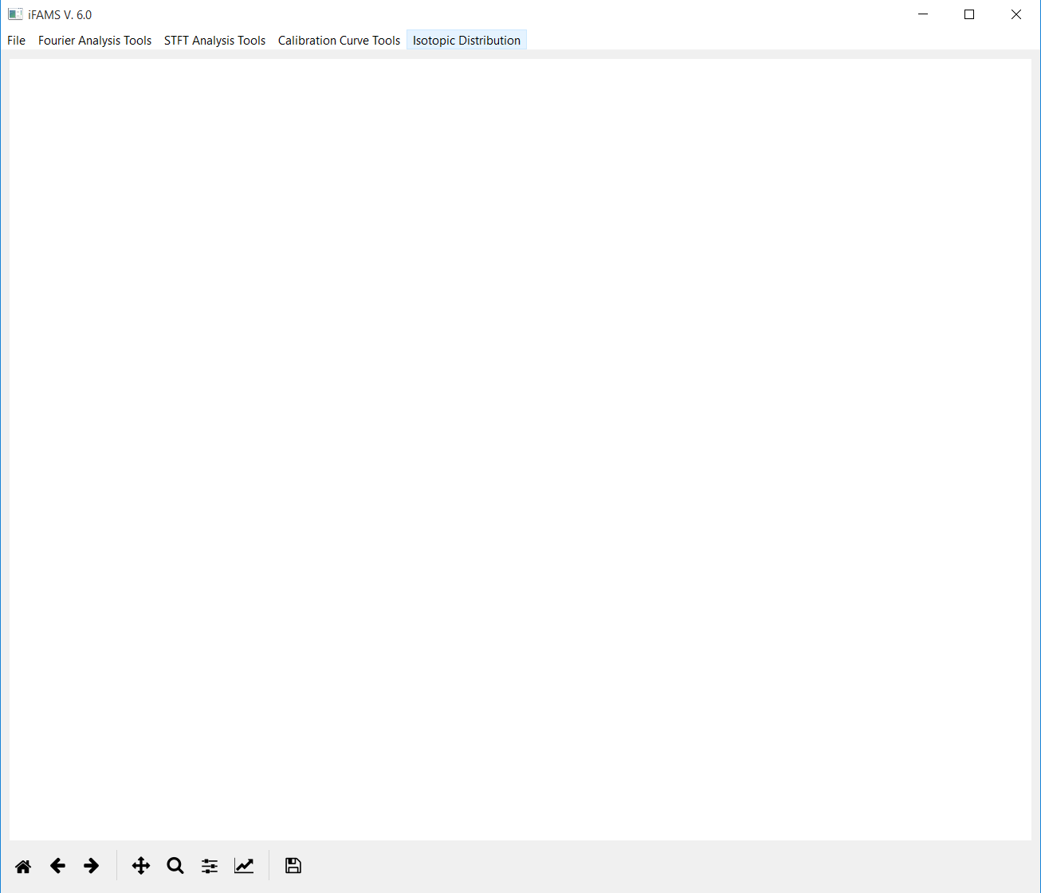
This is how iFAMS v. 6.0 will look when you open the program.

Slide 3
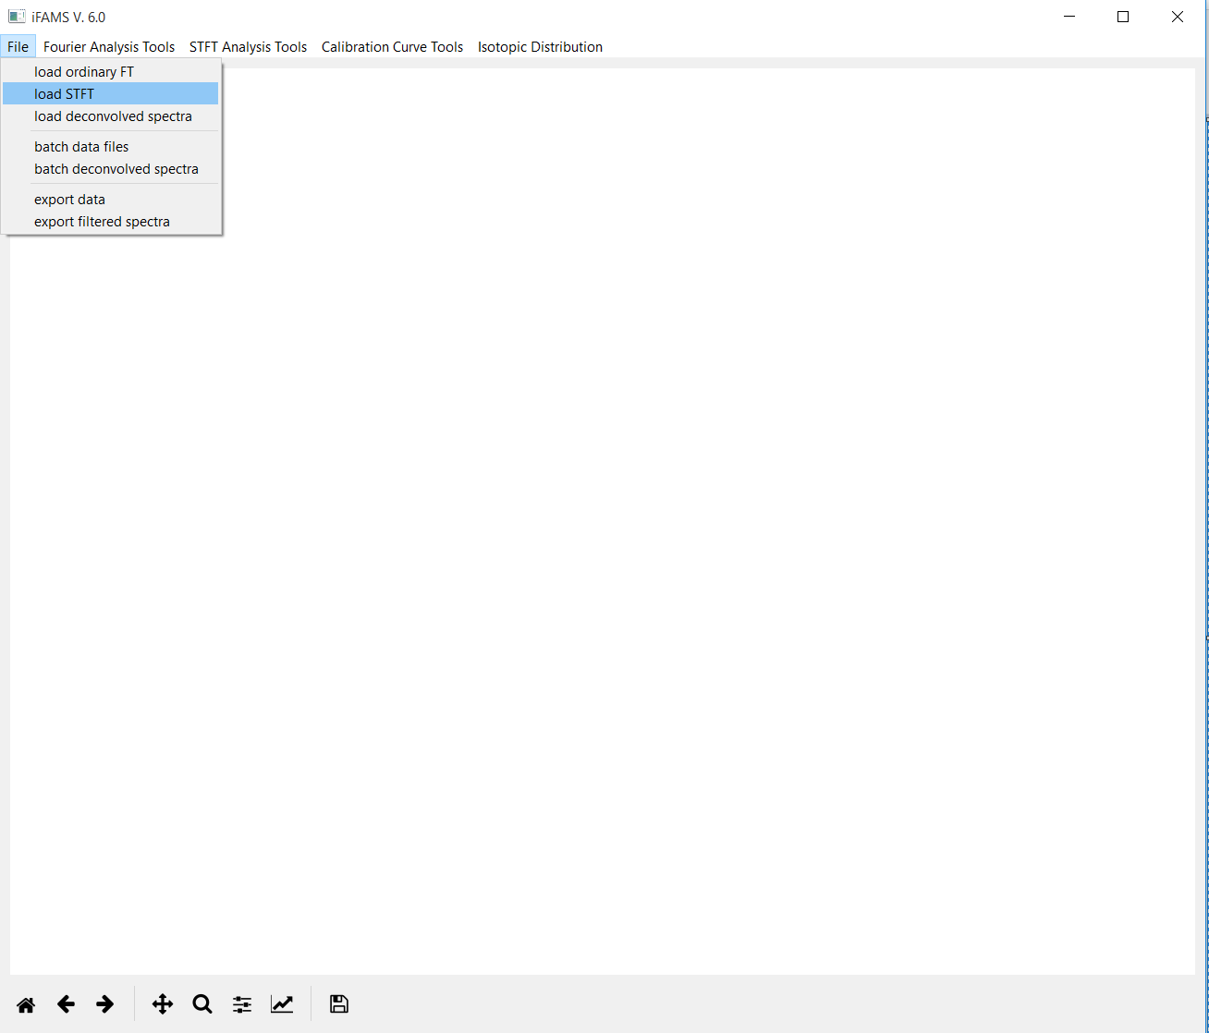
STFT stands for “Short-Time Fourier Transform”, of which Gábor Transform
is the subtype we will be using.
Mass spectrum files must have m/z as the first column, abundance as the second.
.csv and .txt are both acceptable.

Slide 4
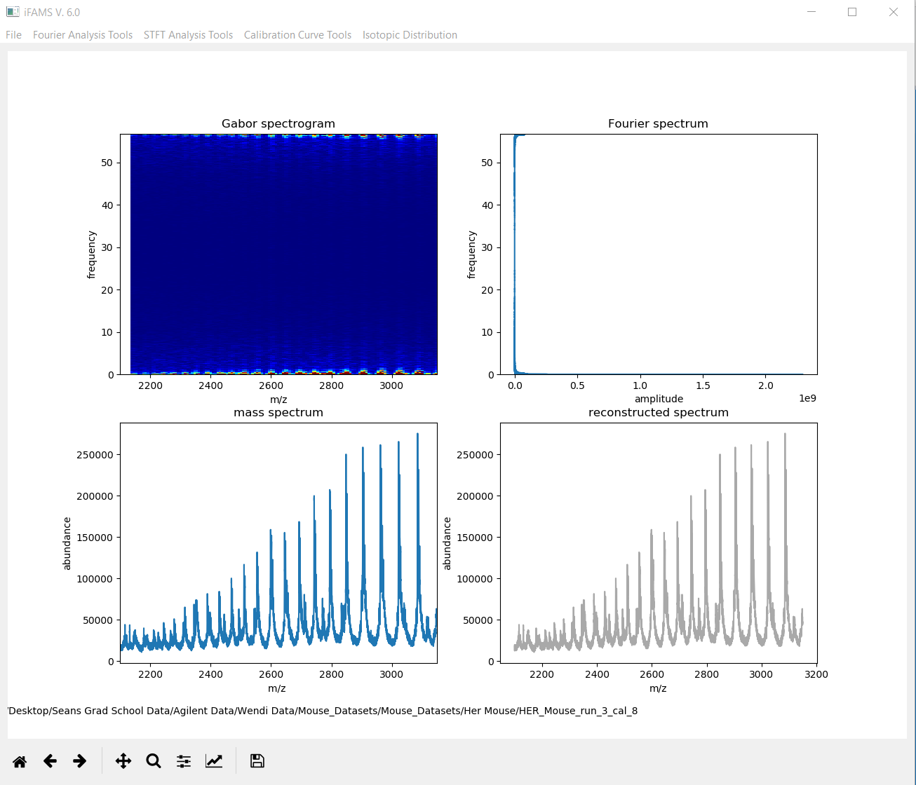
Interactive panel showing the
GT where you will select data
for processing.
Corresponding FT of the
data file. You don’t need
to interact with this.
Your original
mass spectrum.
Results in progress
will show down
here.
Path to your data file
Home = original view, ← undo zoom, → redo zoom, pan, zoom

Slide 5

The important signals for
your protein are the
reddish humps at low
frequency.
Click the zoom icon
and then draw a box
in the Gabor spectrogram
for the region you want
to zoom in on.

Slide 6
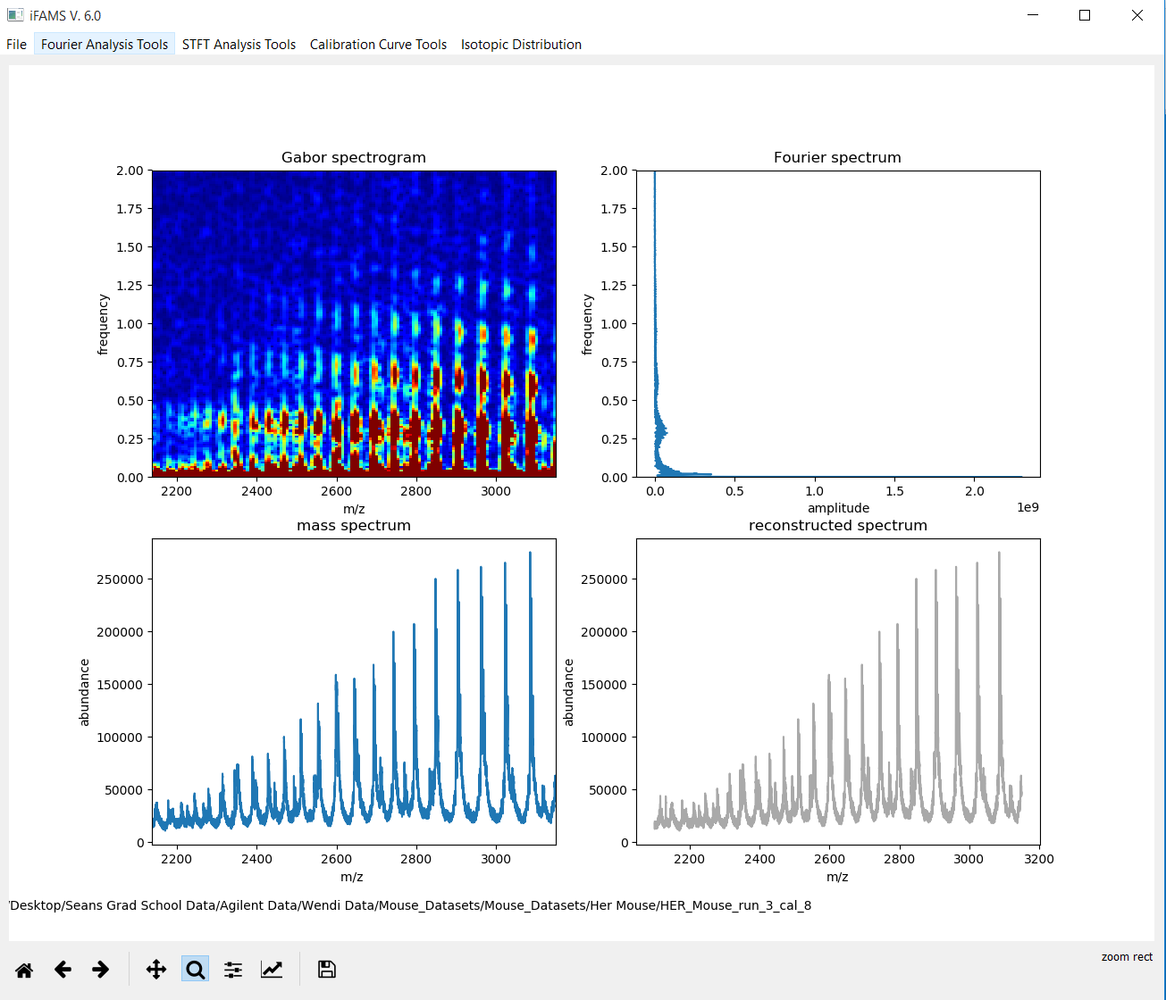
We’ve zoomed in, and
now you can see
the fundamentals
and several harmonics.
4th harmonics
3rd harmonics
2nd harmonics
fundamentals

Slide 7
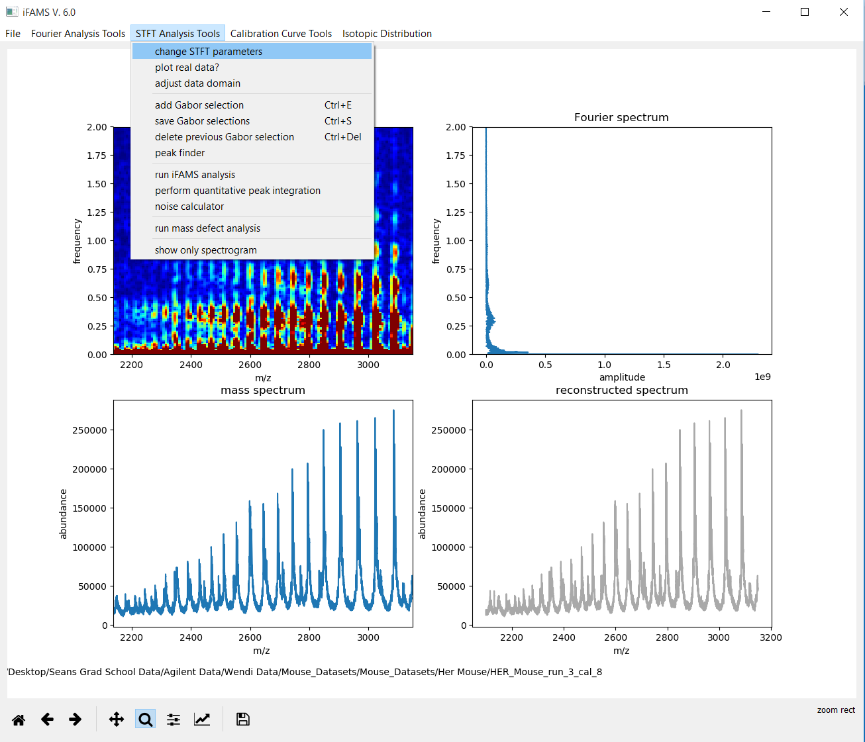
We should change the STFT
processing parameters
to make it easier to
select out each charge
state.

Slide 8
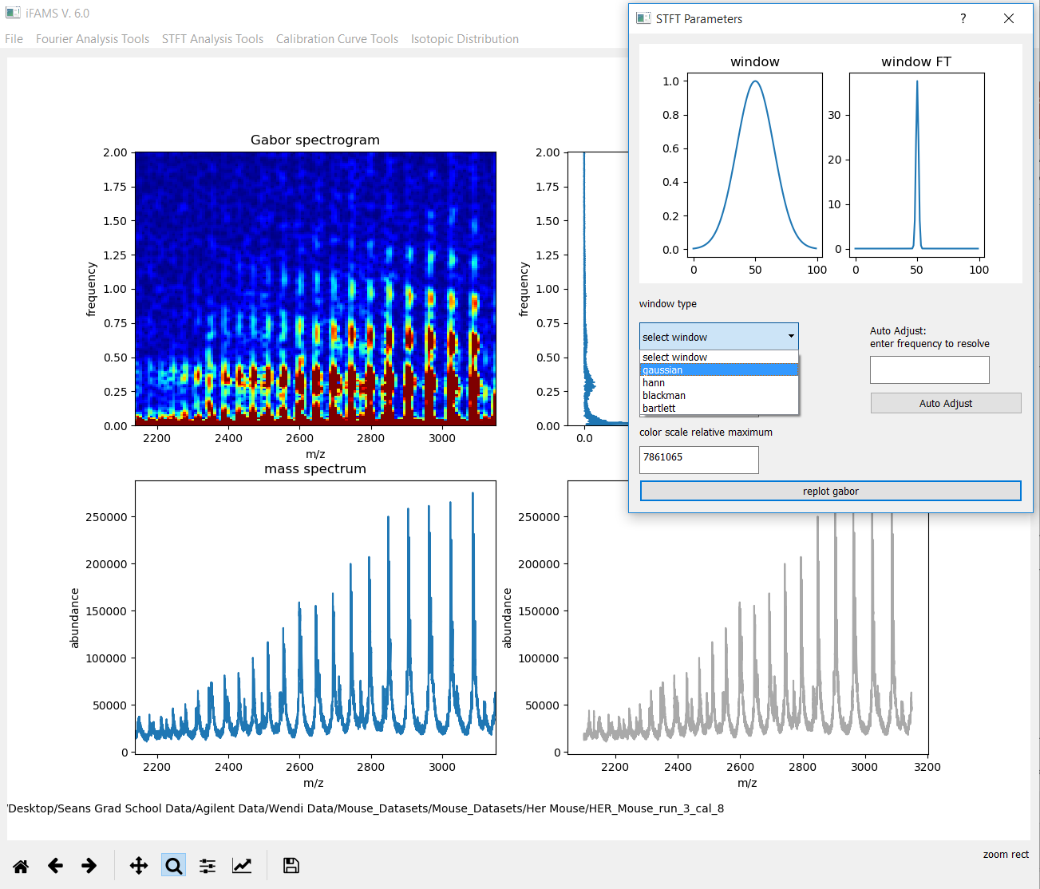
Generally, a Gaussian
window is best, but
you need to select it.

Slide 9
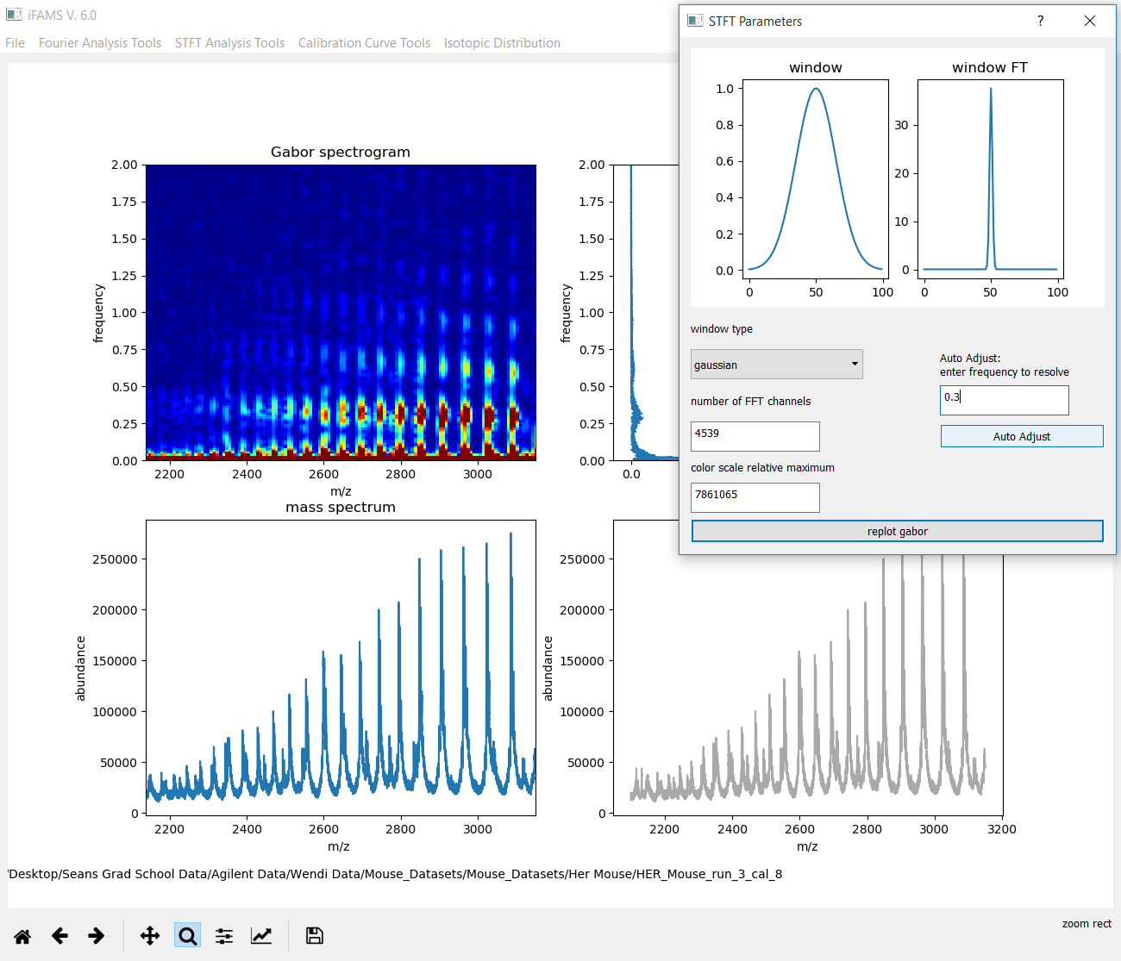
Change the “Auto Adjust”
to be some frequency
roughly in the middle of
the fundamentals.
This should make it easier
to select out each charge
state.

Slide 10
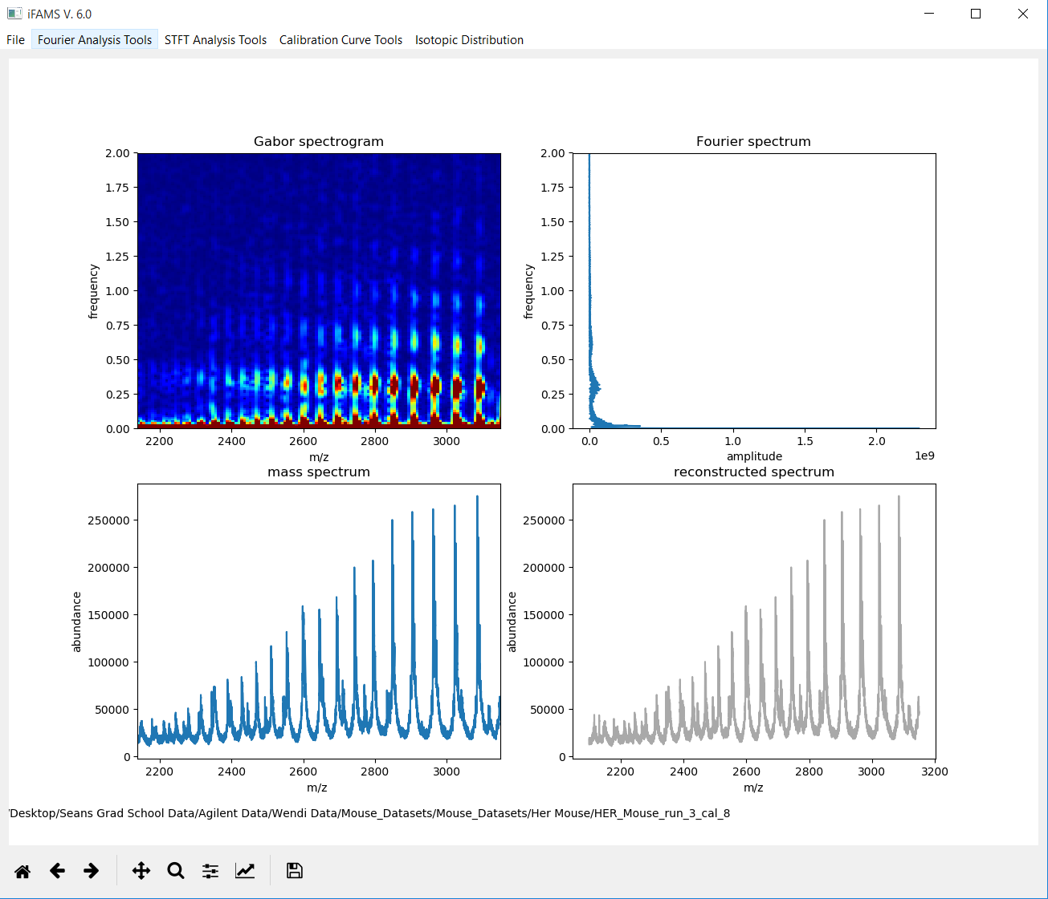
Much better!
You can repeat that step
until you see each
fundamental and harmonic
becoming as well-separated
as possible.
Don’t stress out too much
about getting it perfect.

Slide 11

After you unselect the
zoom icon, pick any
fundamental you like.
Click and drag a box
around it that doesn’t
run into other peaks.

Slide 12

Now type Ctrl-E.
The Inverse GT of
your selection will
show up in the
bottom right panel.
If possible, avoid selecting
peaks that have strong
contaminant interferences
to the immediate left
or right of the desired
peak.

Slide 13
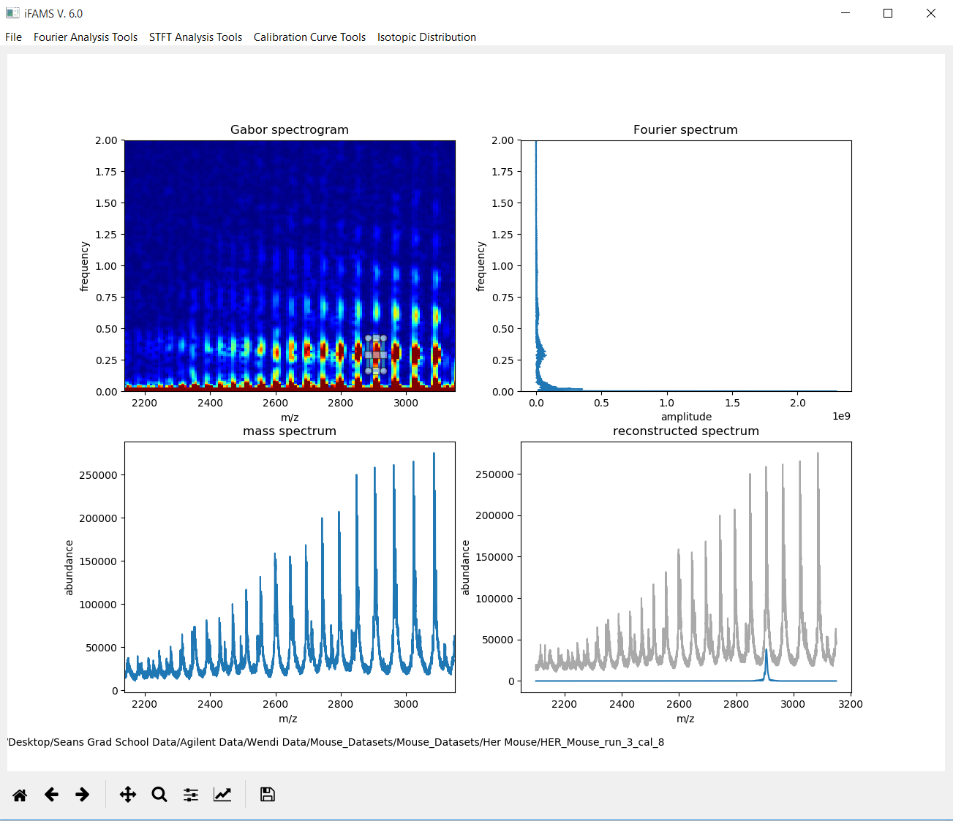
If you are happy with your
selection, type Ctrl-S to
save it, so you can move
on to the next selection.

Slide 14

Select another fundamental
immediately to the left
or right of the one you
just finished.
Again, type Ctrl-E and Ctrl-S
to save.

Slide 15
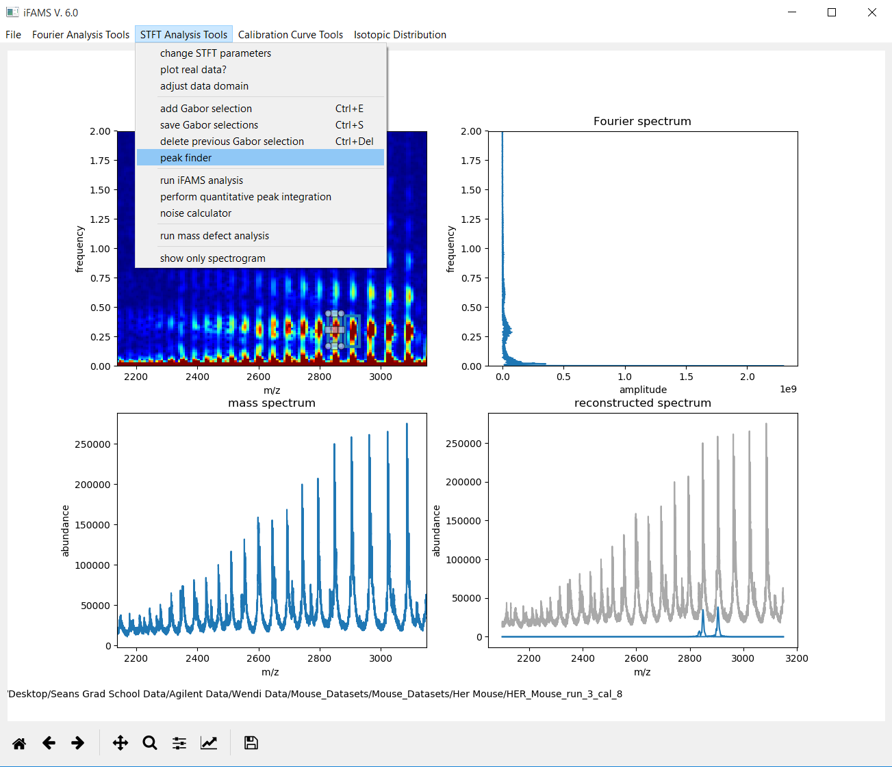
iFAMS will now find all of
the other fundamentals
based on the two you
just picked.

Slide 16
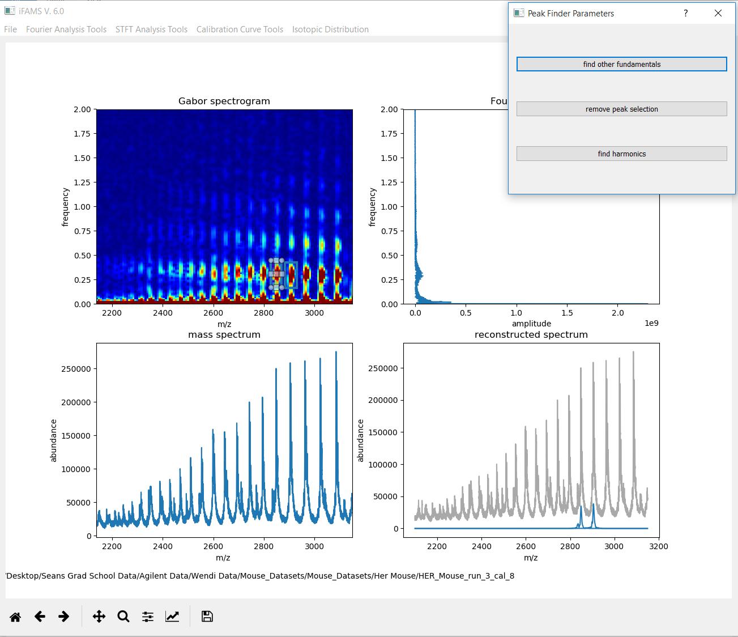
Click “find other
fundamentals”.
Note that this will take
a few moments.

Slide 17
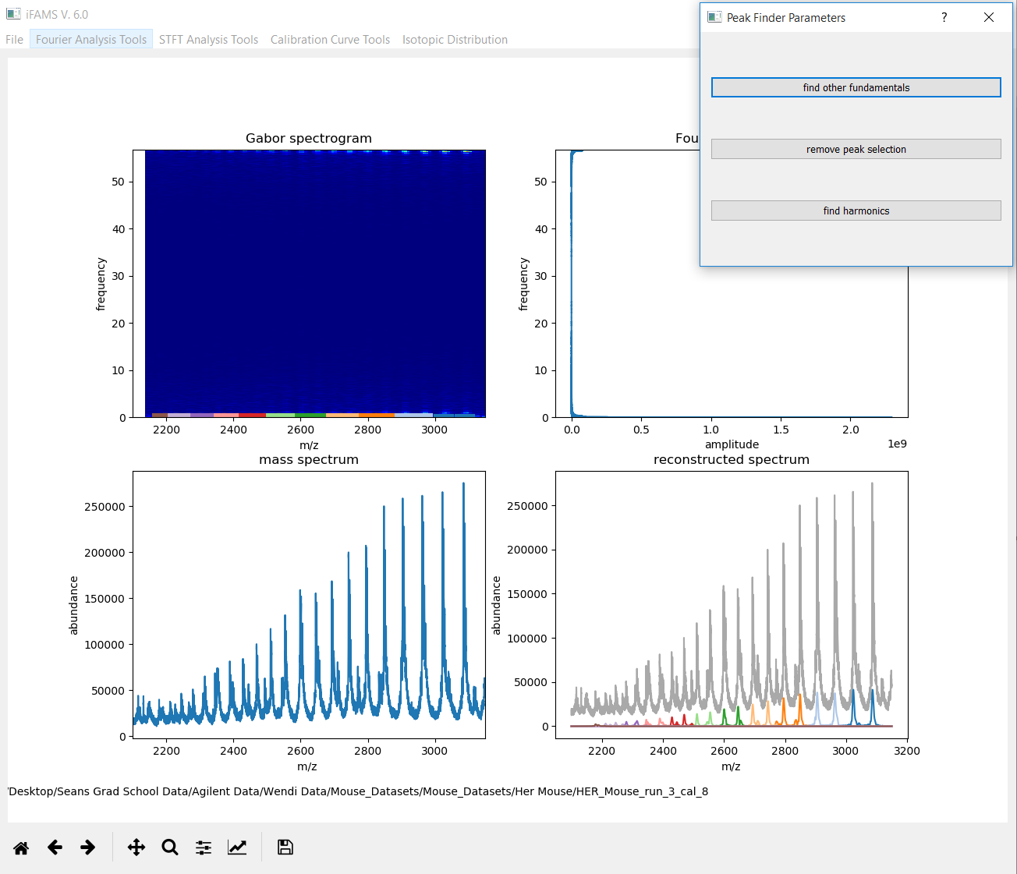
iFAMS now displays the
GT (zoomed back out)
with all the charge states
it found, each in a different
color, corresponding to the
traces in the bottom right
panel—one for each charge
state.
Now is a good time to make
sure that there is one
clear peak for each
charge state, and that
none appears to be
skipped. (Start over, if
there is a problem.)

Slide 18
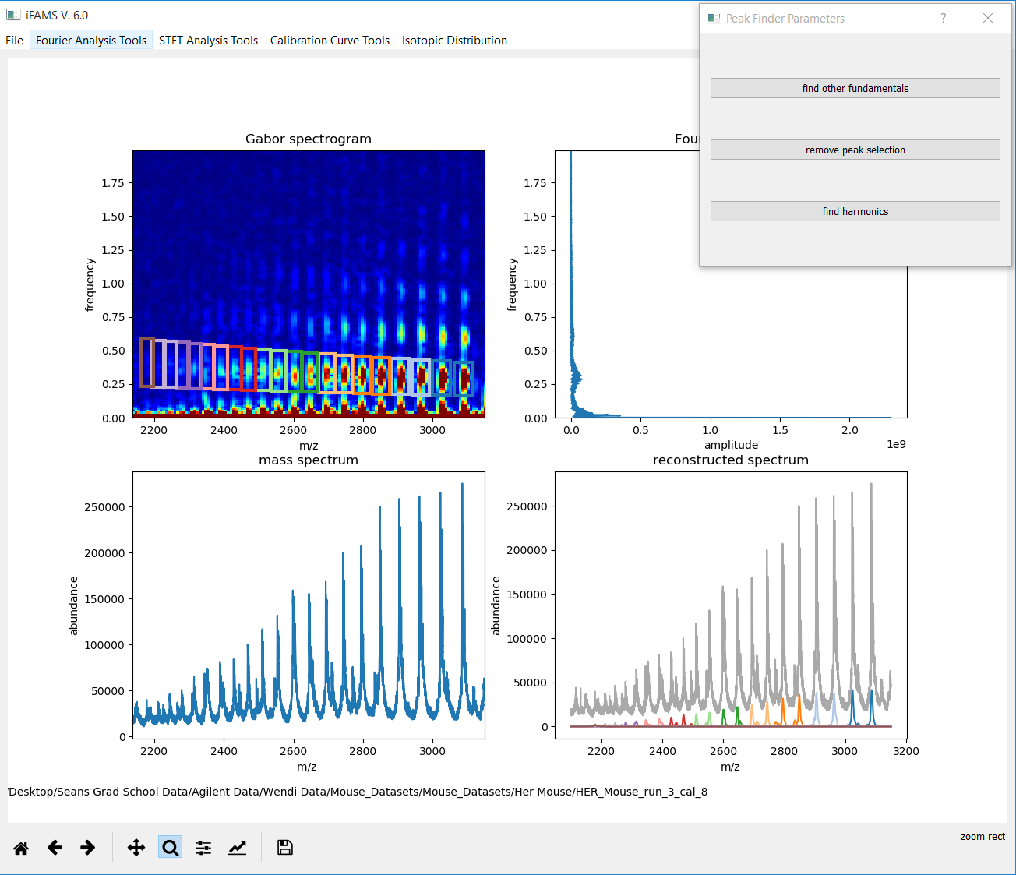
If you zoom in again on
the GT panel (don’t
forget to click the zoom
icon first!), you can see
the boxes much more
clearly.

Slide 19
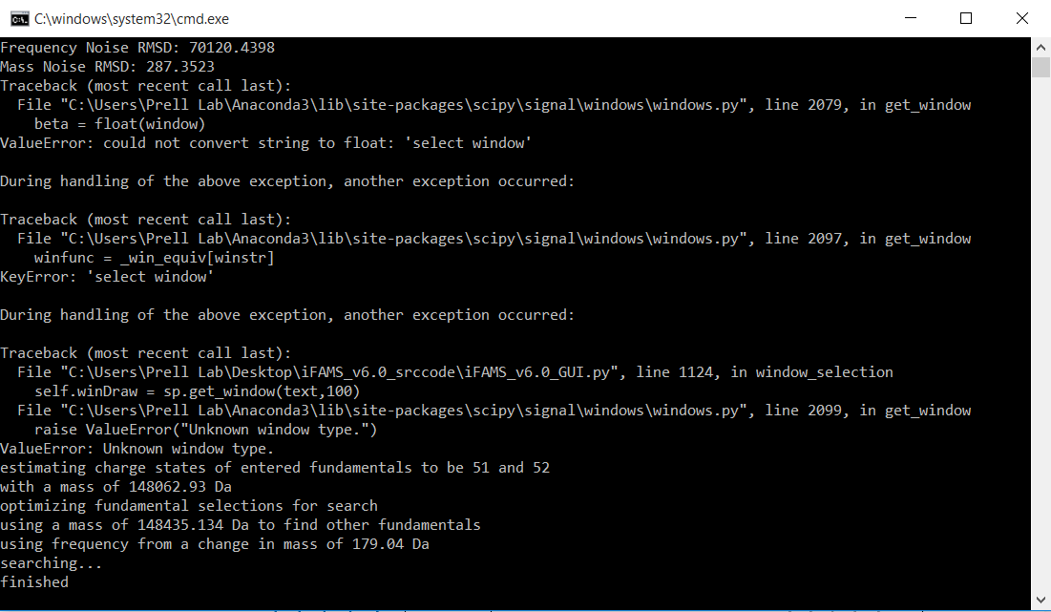
In the background command prompt (often behind the iFAMS GUI in Windows), you will see some potentially useful
information, such as a rough estimate of the charge states of the two peaks you originally selected, the mass of the
subunit that gives rise to the frequencies of the fundamentals (e.g., the average mass spacing of the glycans in your
glycoform profile), and a rough estimate of the protein mass.
We recommend checking here if your results seem wrong or odd.

Slide 20
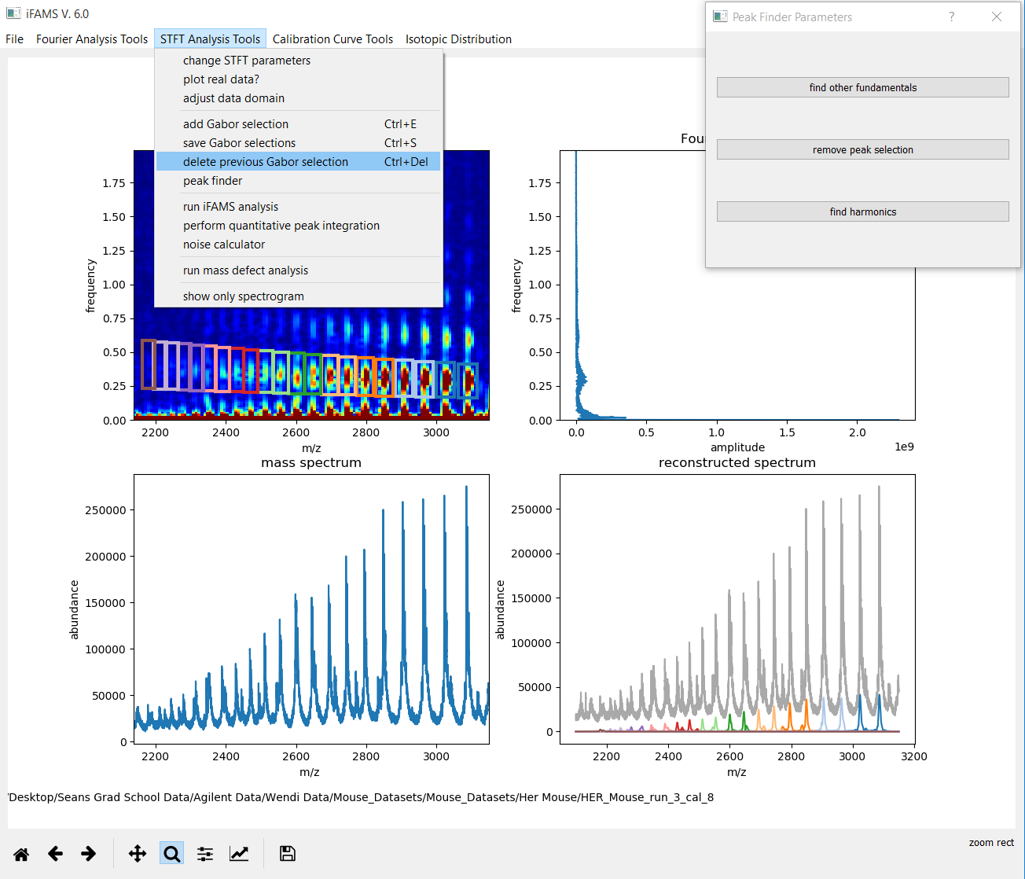
Maybe you want to remove
some of the highest
charge states, which have
very low signal?
If so, you can easily delete
them one by one.

Slide 21
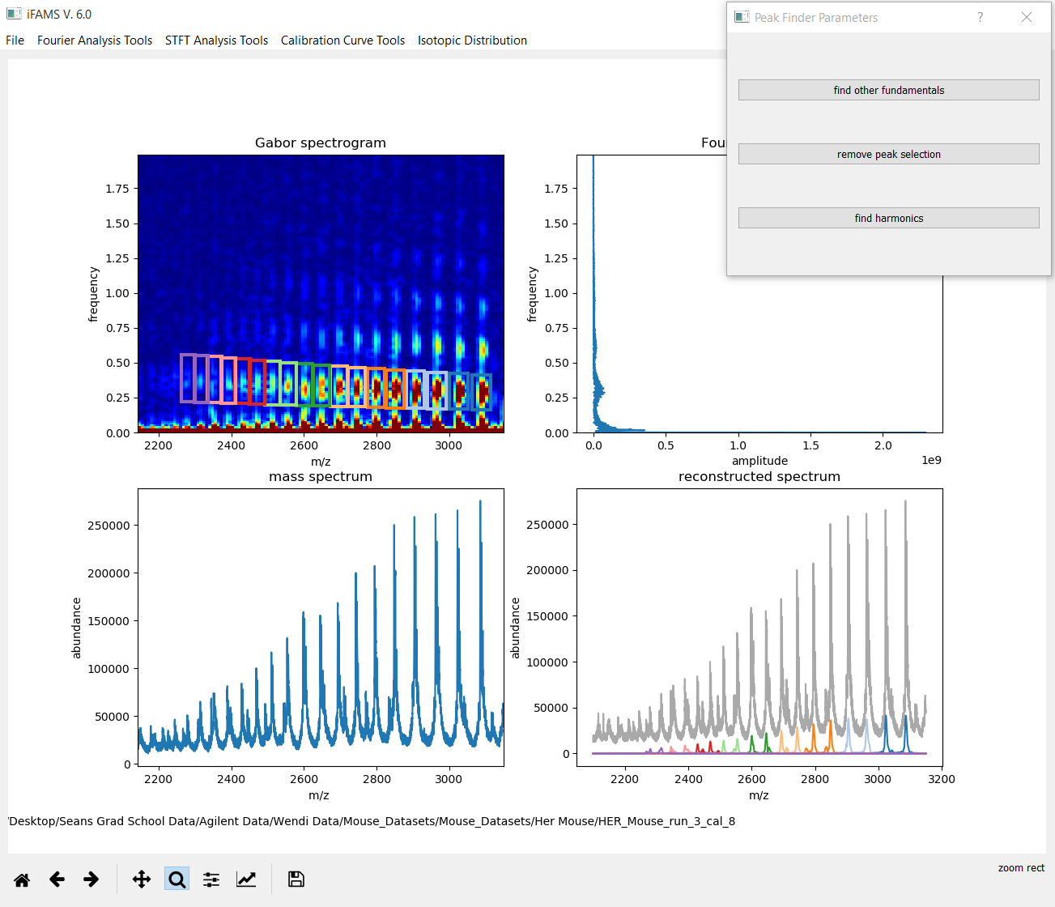
Here, we deleted the
highest three charge
states.

Slide 22

iFAMS is now ready to
select harmonic peaks
based on the fundamentals
you have chosen.
Often, including up through
the 3rd or 4th harmonic
gives good results.

Slide 23


Slide 24
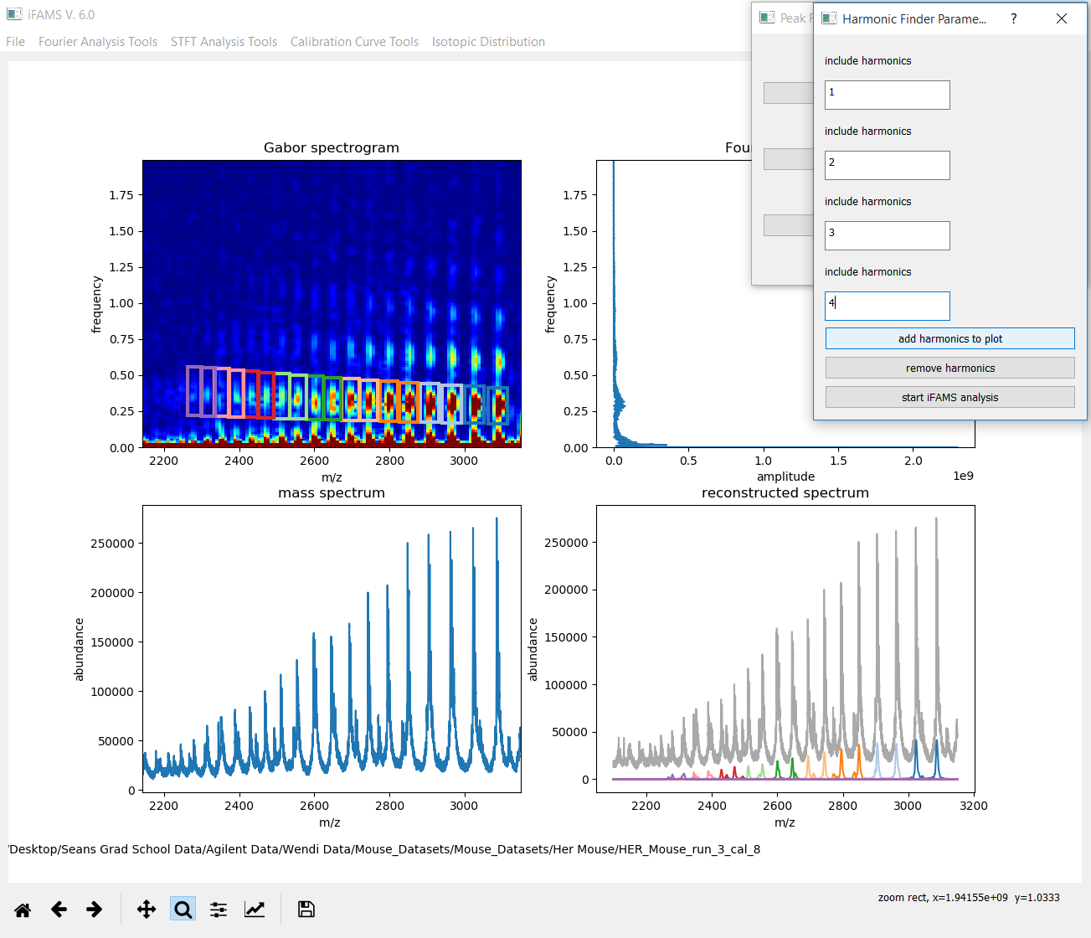
Click “add harmonics
to plot”.

Slide 25
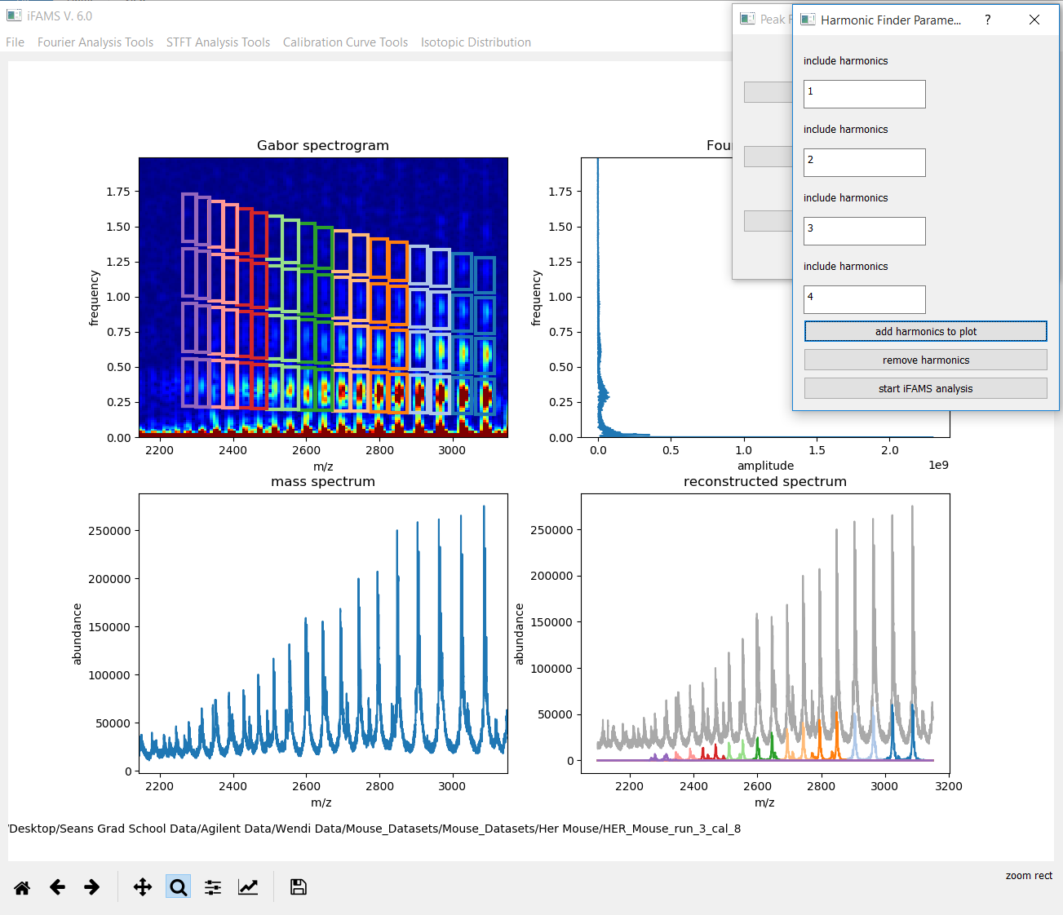
Now you can see that
the fundamentals, 2nd,
3rd, and 4th harmonics
have all been correctly
selected.

Slide 26
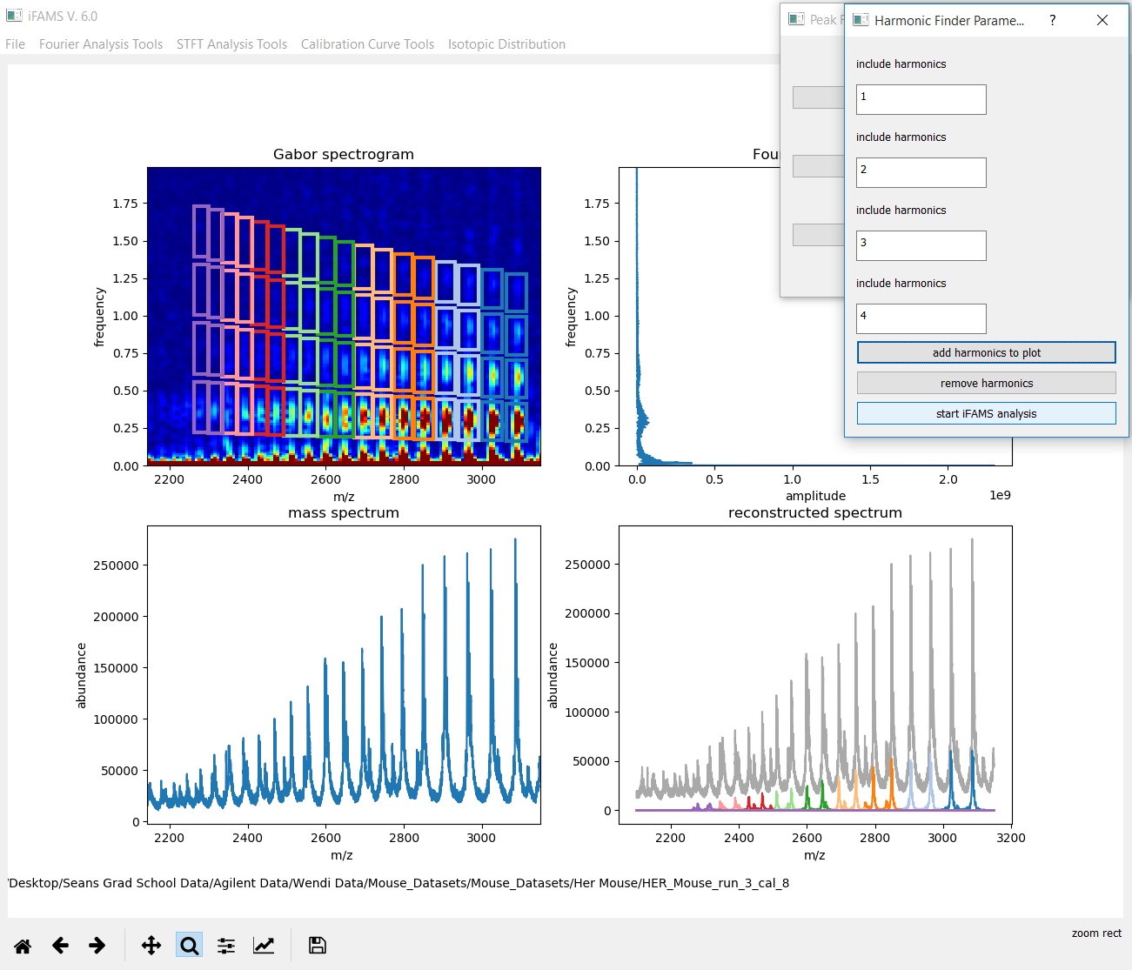
iFAMS is ready to compute
the deconvolved, i.e.,
“zero-charge”, spectrum.

Slide 27
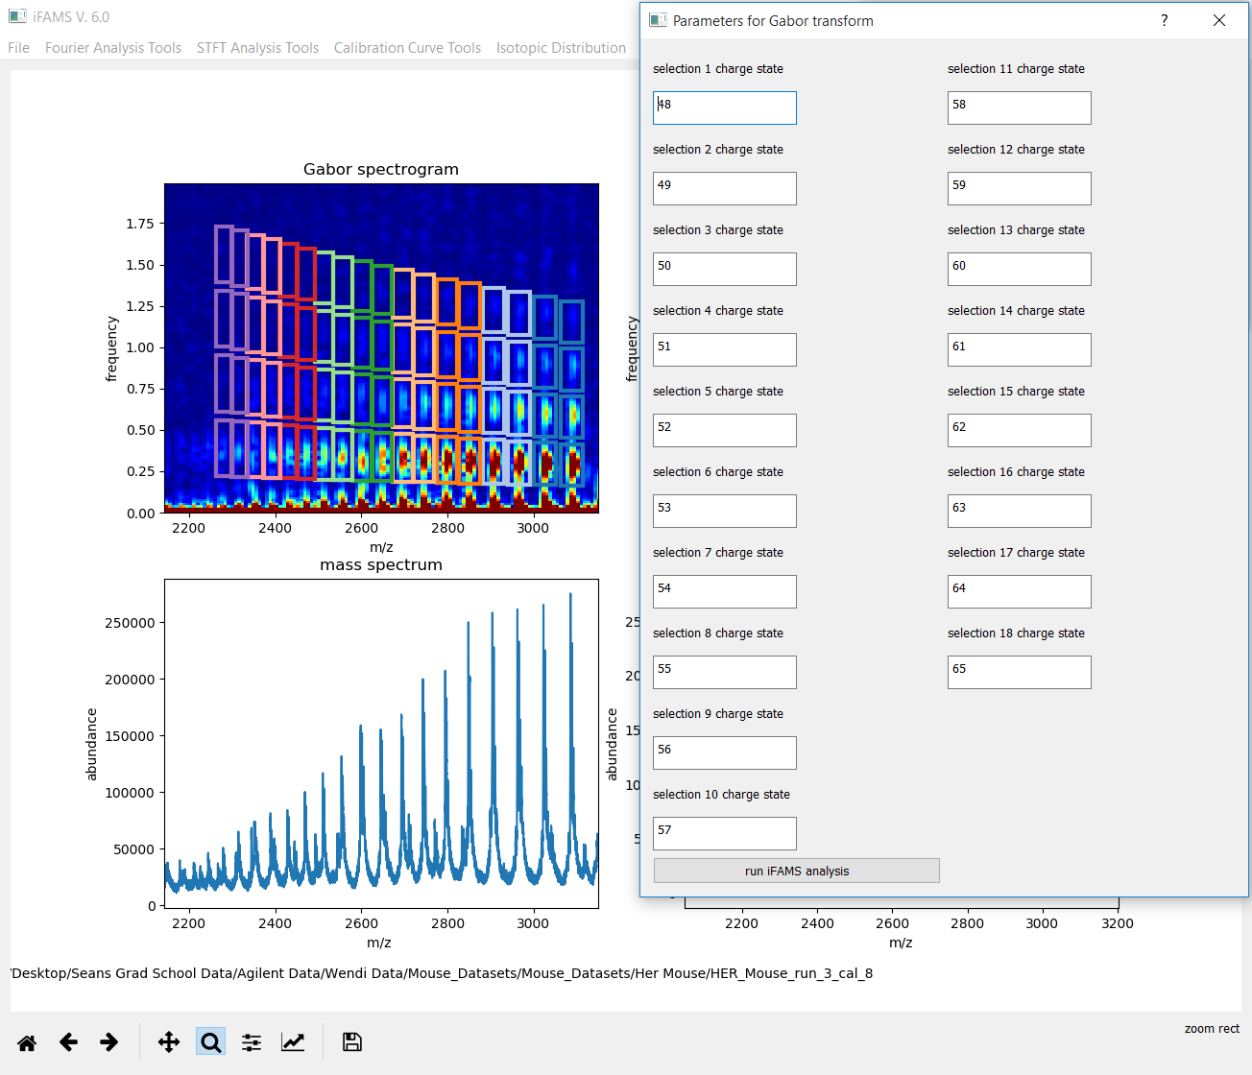
iFAMS will auto-populate
the charge states based
on what it thinks they
are. You can change these
if they are wrong.
They must be populated
from right to left in the
mass spectrum, that is,
from low to high charge
state.

Slide 28

When you are ready,
click “run iFAMS analysis”.

Slide 29
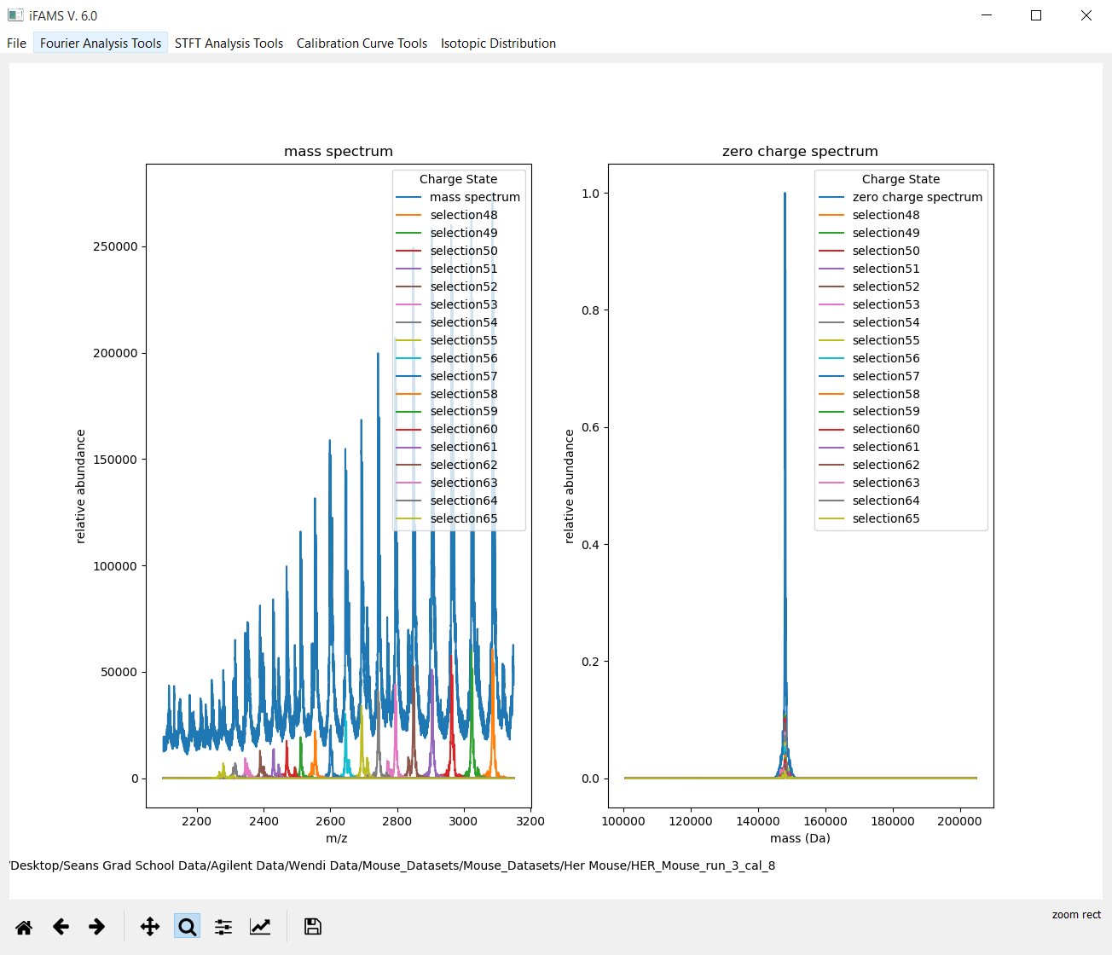
iFAMS now displays the
deconvolved zero-charge
mass spectrum, with
the contribution from
each charge state overlaid
on the large, blue
total spectrum.

Slide 30
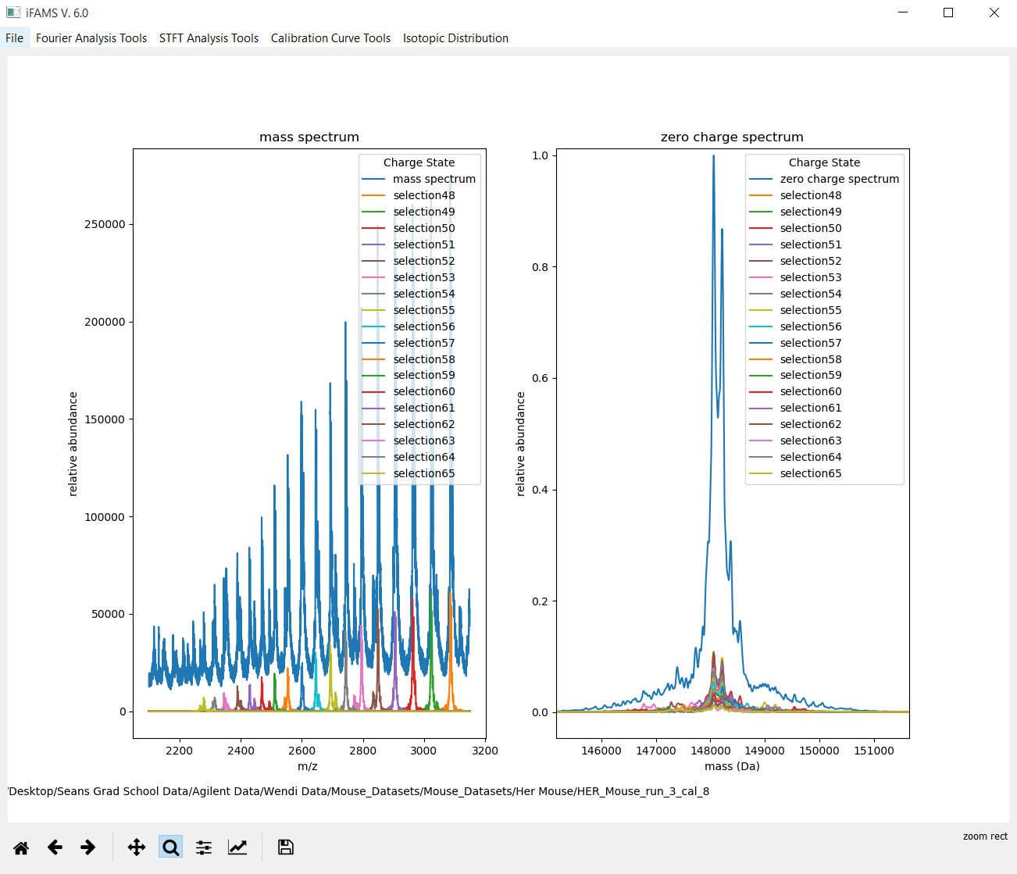
We have zoomed in a bit
here. Note the good
overlap of each charge
state’s contribution.
That indicates a good
deconvolution and
correct assignment of
charge states.

Slide 31
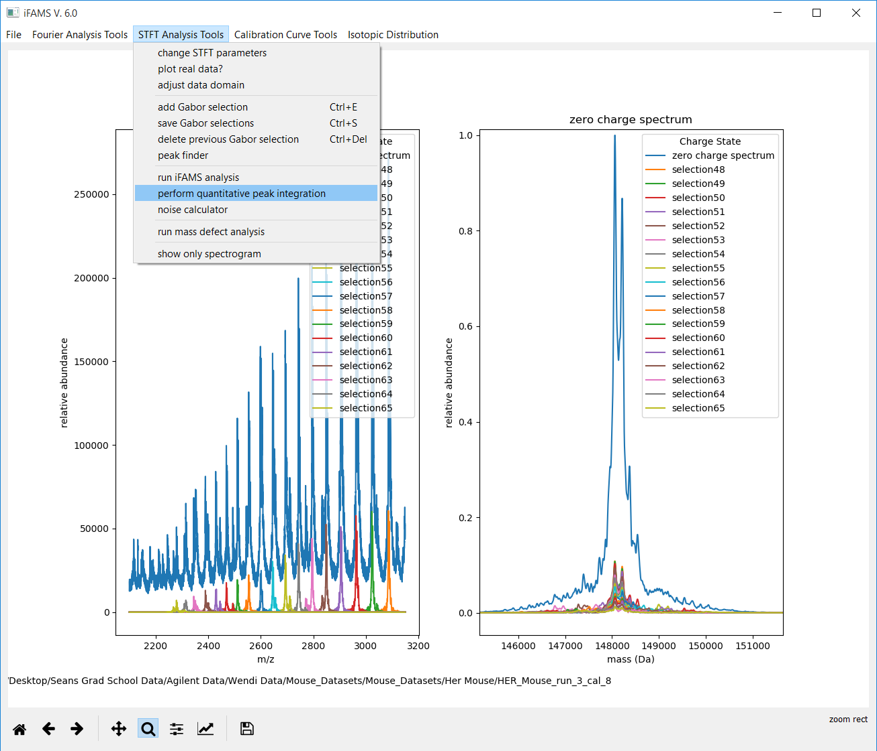
Now we are ready to
compute integrated
peak areas and read off
peak heights, either
of which can be used
later for calibration and
quantitation.

Slide 32
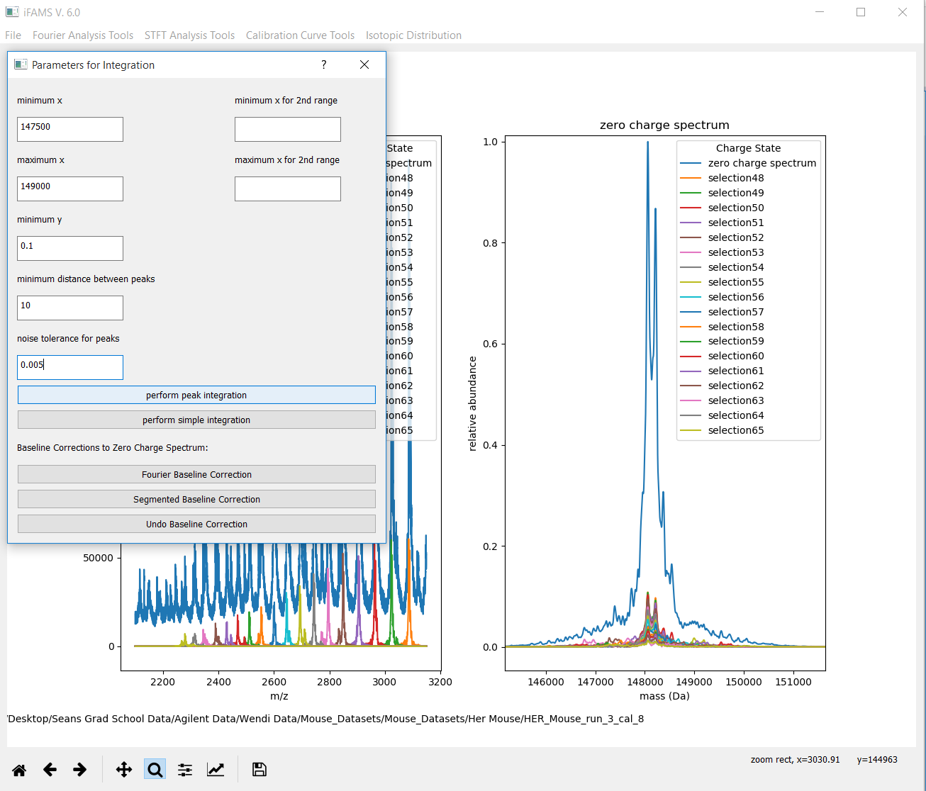
These parameters
should be self-
explanatory,
other than
minimum distance
between peaks
(we recommend a
value of 10) and
noise tolerance.
Here, we have told
iFAMS to ignore
bumps smaller than
0.5% of the tallest
peak in the spectrum,
a good default setting.

Slide 33
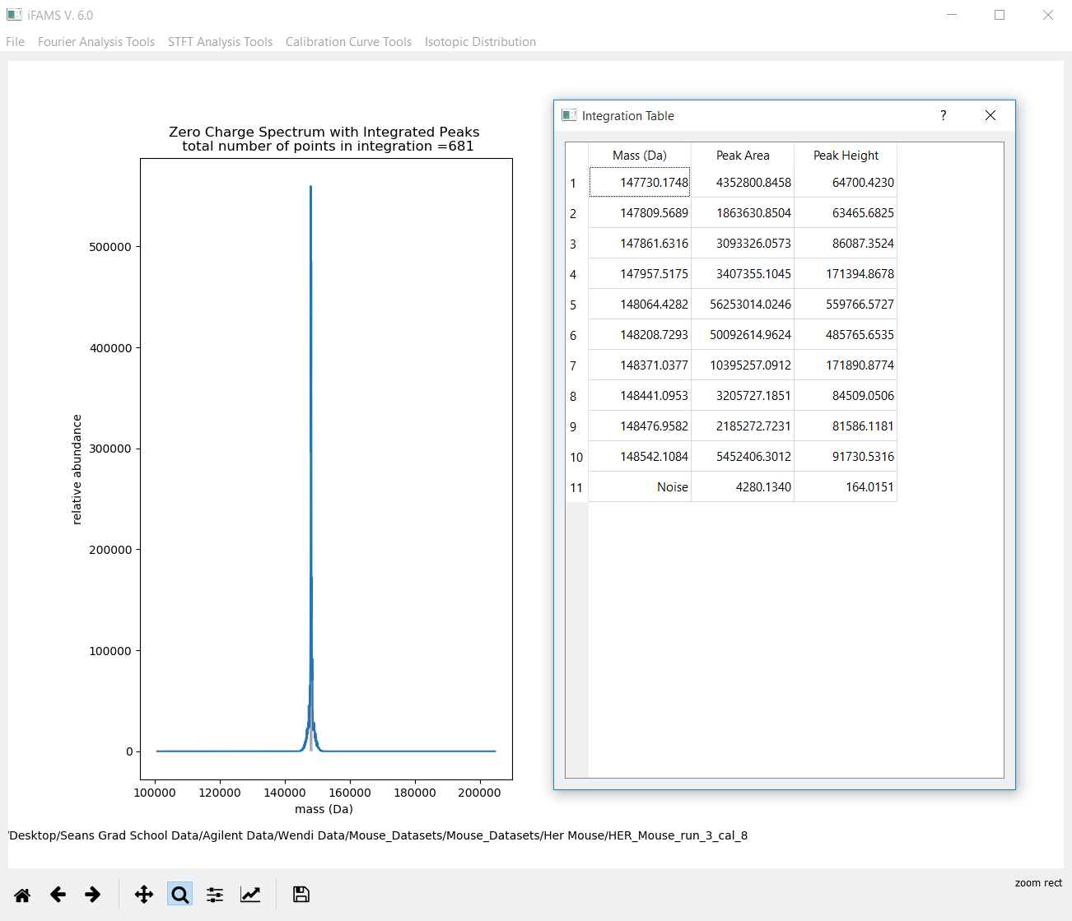
After clicking “perform
peak integration”,
iFAMS will display
the average mass,
area, and height
of each peak that
fit your criteria
from the previous menu.

Slide 34
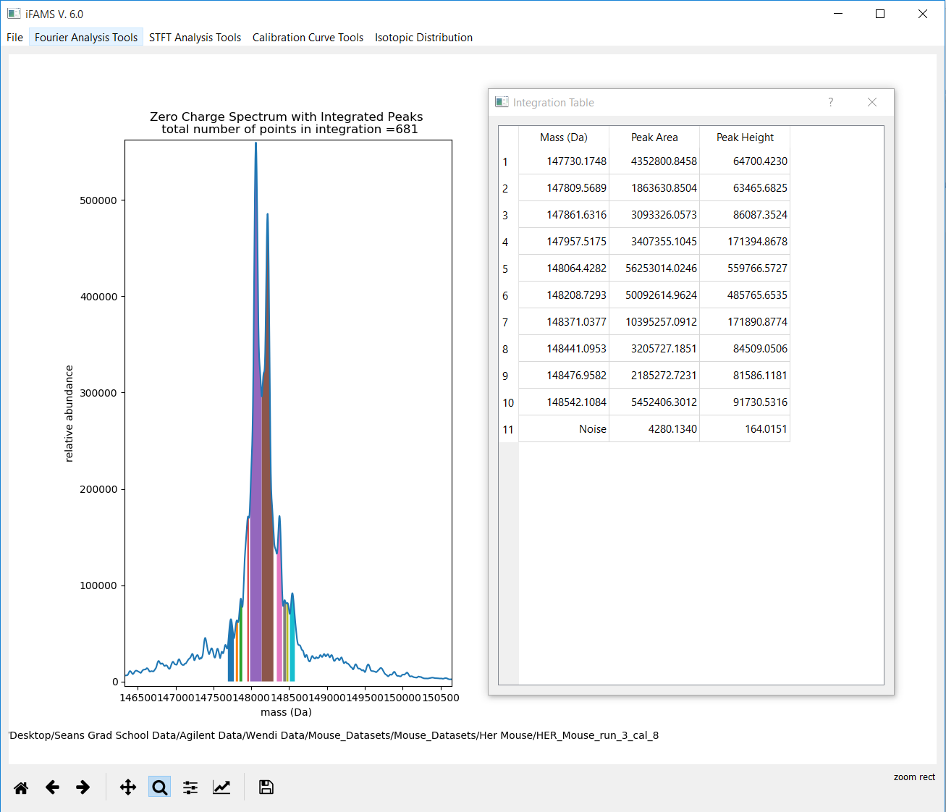
If you zoom in, you can
see exactly what iFAMS
thinks your peaks are,
including the bounds
of integration that it
used for each.

Slide 35
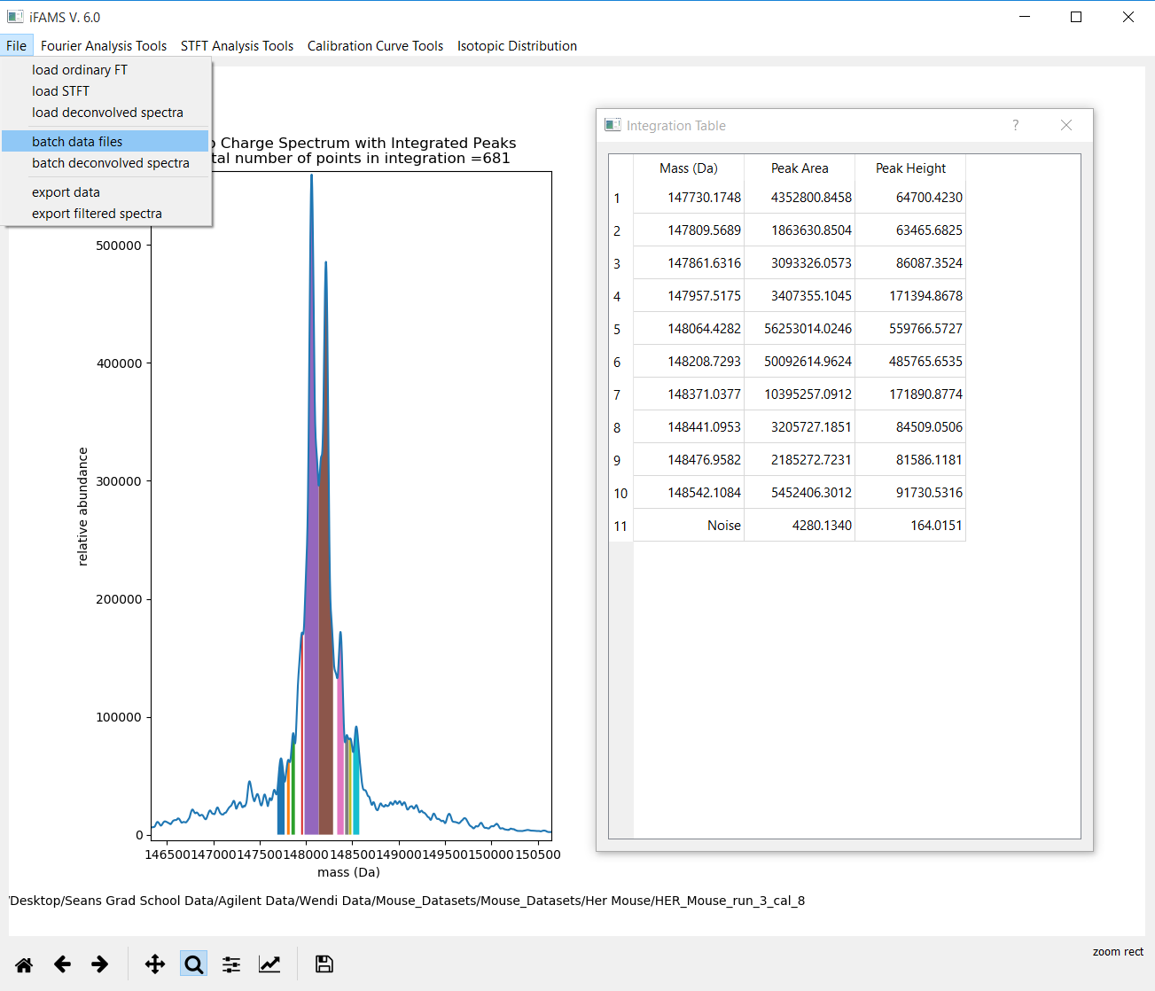
You can repeat the
quantitative peak
integration step
as needed, changing
the parameters until
you are satisfied
with the results.
When you are done,
you can now batch
process all of your
other calibrant
files, QC’s, and
unknowns with
exactly the same
parameters as
your final set from
the current data.

Slide 36
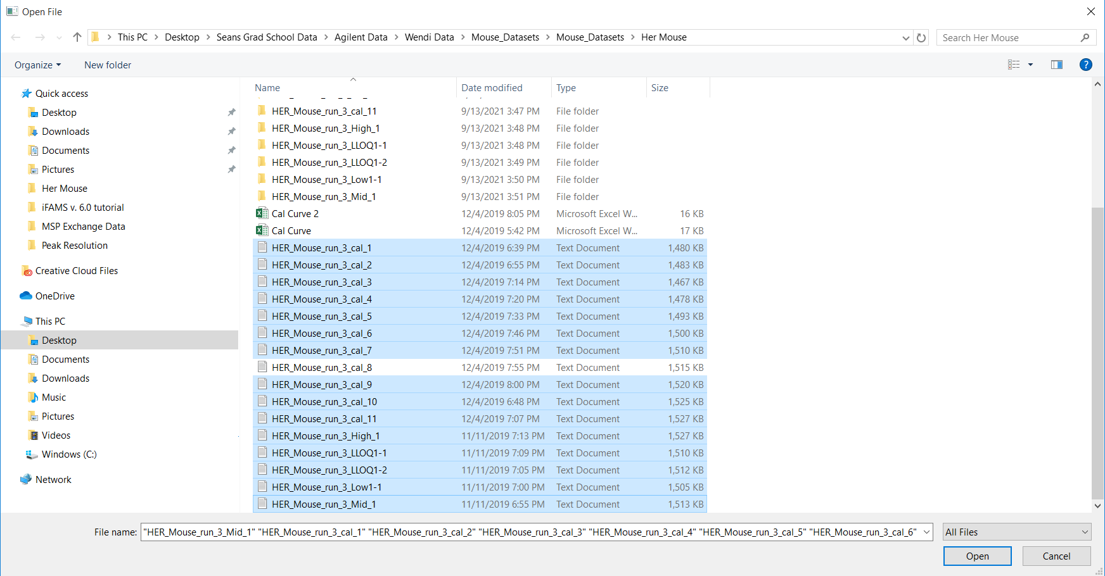
Make sure that all the data you want to batch process are .txt or .csv files in the same folder as the file you
have been working with up to this point. iFAMS will automatically create a new subfolder containing results
for each individual mass spectrum (just like the subfolders at the top in this image, which are actually
left over from a previous run we did!). You do not need to re-process the file you were just running.

Slide 37
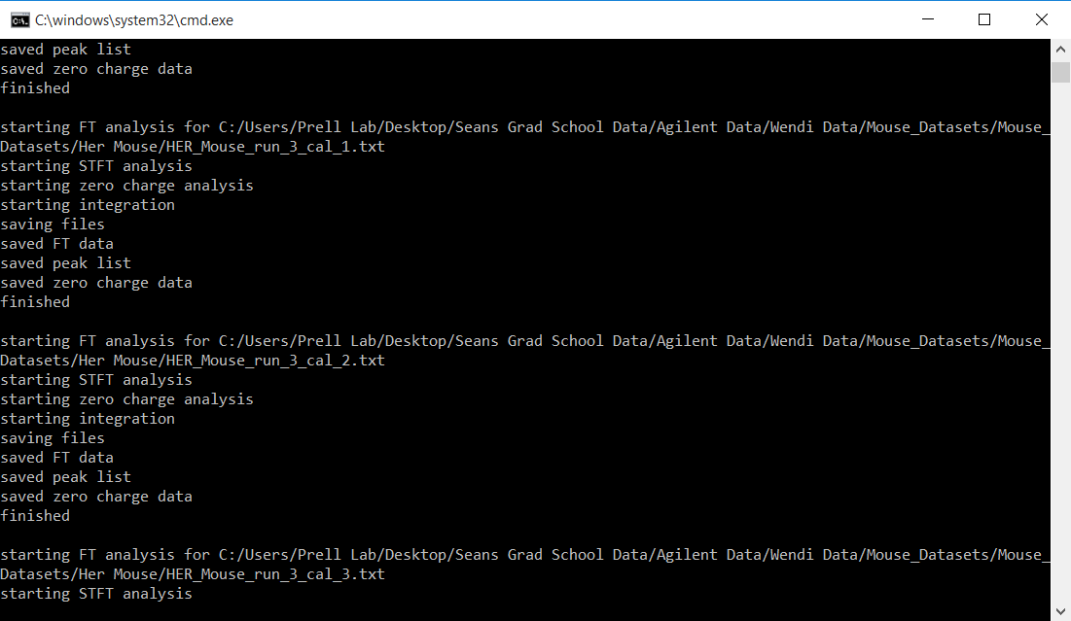
This is just a glimpse of the output in the command prompt in the background. If things are going smoothly,
you should see messages like these for each data file you are batch processing.

Slide 38
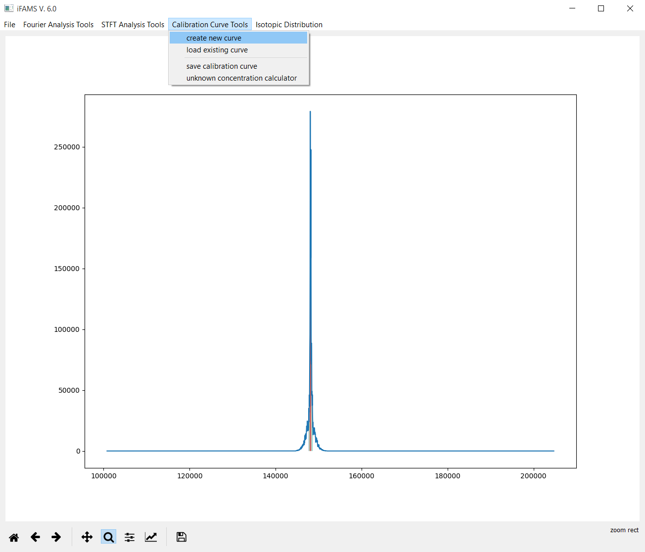
After iFAMS finishes
batch processing,
we can create a
calibration curve.

Slide 39
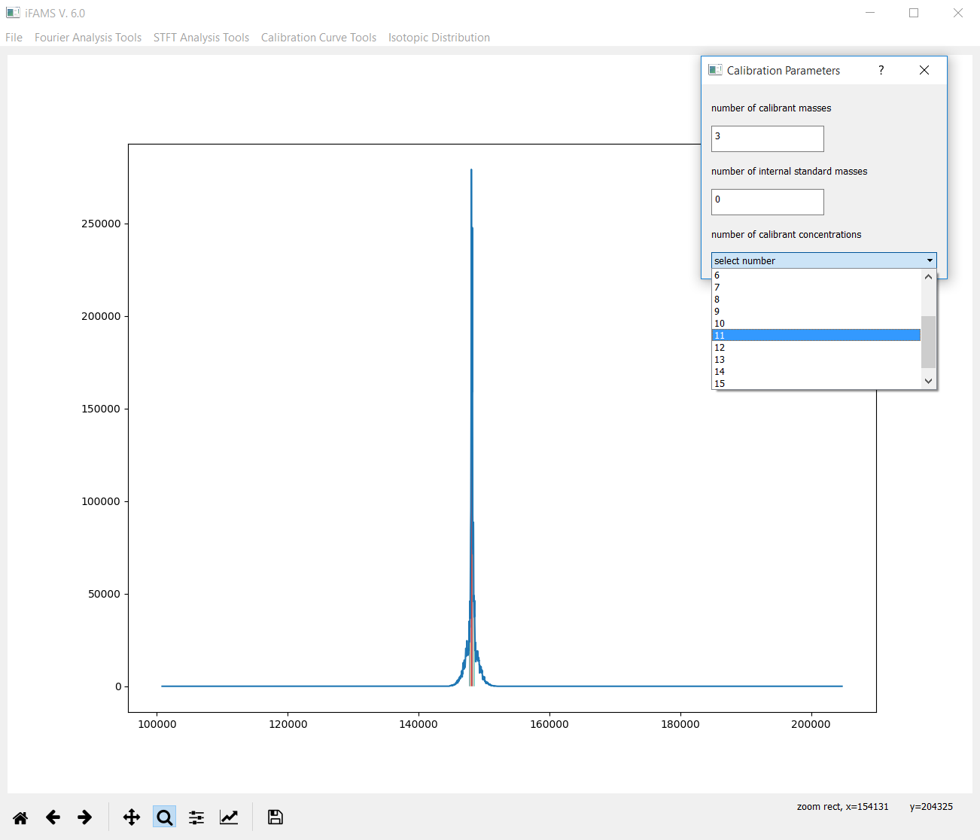
Tell iFAMS the number of
calibrant mass peaks
you want to sum over
for each concentration.
If you have no internal
standards, leave the
“number of internal
standard masses” as 0.
Finally, tell iFAMS how
many total calibrant
concentrations you
are using to make your
curve.

Slide 40
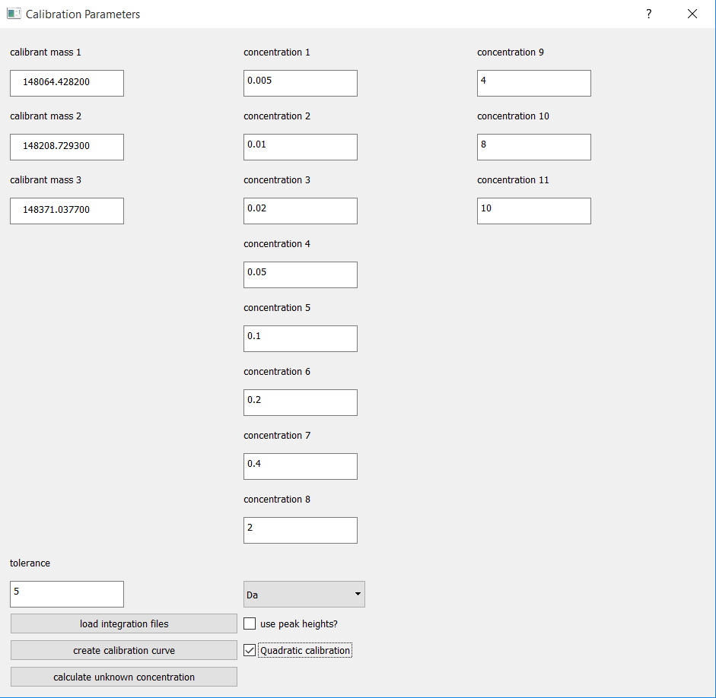
Here, we are using
the three biggest
peaks from the
“peaklist” output, and
we have told iFAMS to
tolerate up to 5 Da
error for each.
You can use whichever
peaks you like.
We have also selected
“Quadratic calibration”;
you will get a linear fit
if this is not selected.
Default is to use integrated
peak areas (recommended!),
but you can opt to use
peak heights instead.
Make sure to input the
concentrations in the
same order as you use
when you click “load
integration files”!

Slide 41
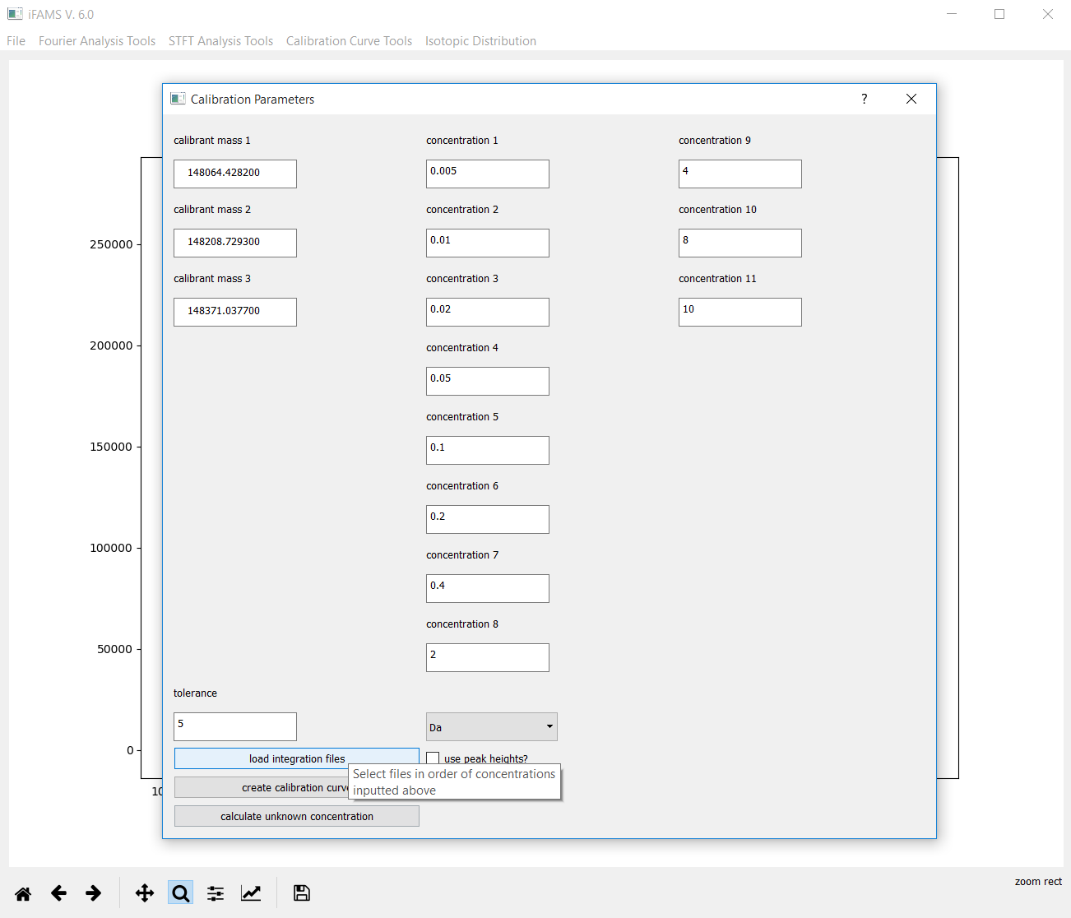
Everything is all set to
load the integration
files.

Slide 42
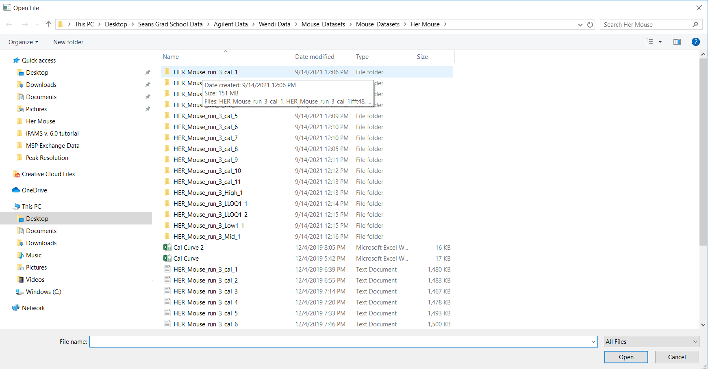
The integration files you need are inside each of the folders iFAMS created during the batch process step.
Open the first one and select the “peaklist” file within it. Then click “Open” in the bottom right hand corner.
iFAMS will then immediately await your next file selection. Repeat these two steps until you have selected
all of the appropriate “peaklist” files.

Slide 43
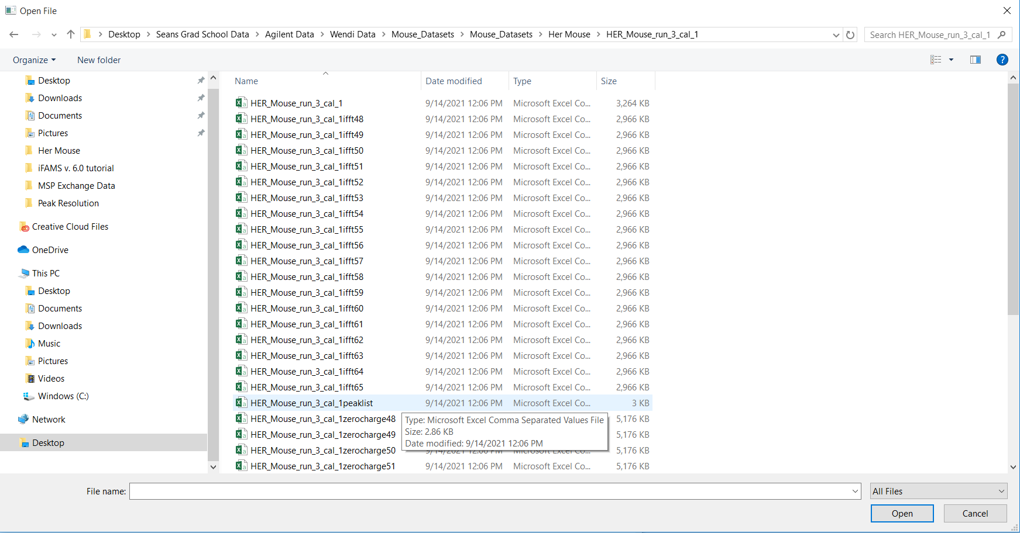
This is an example of a “peaklist” file.

Slide 44
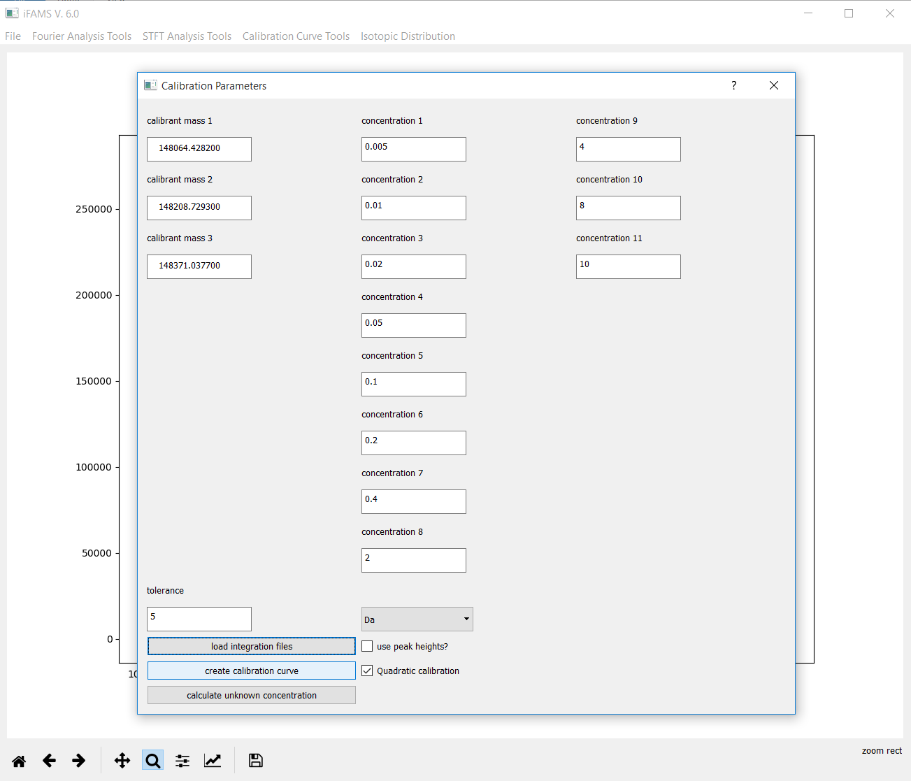
Now click “create
calibration curve”!

Slide 45
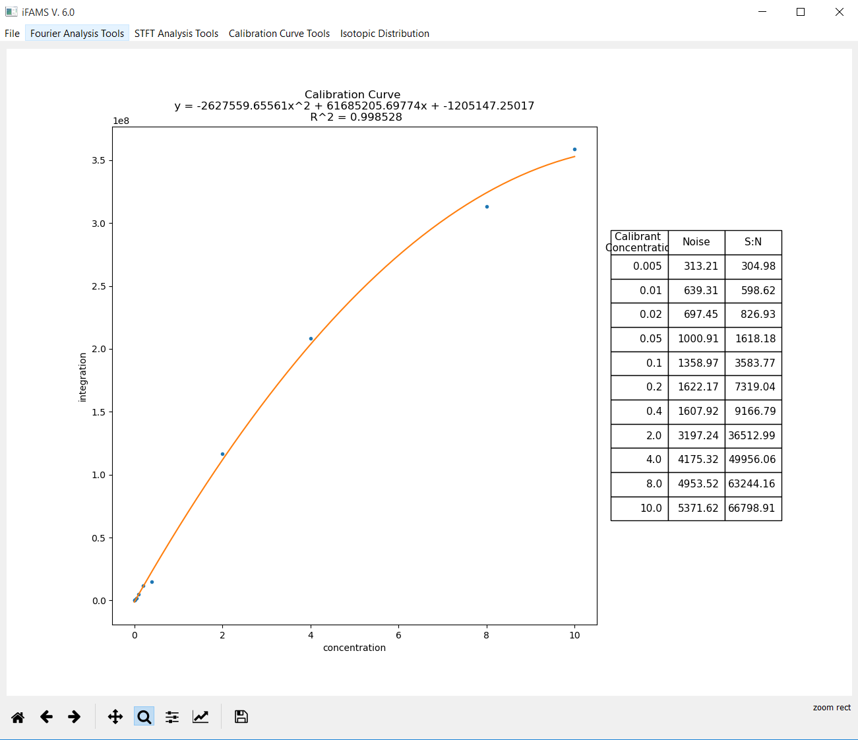
iFAMS will show you the
equation of your calibration
curve, the R² value, and a
table of the total integrated
noise and signal-to-noise
for each concentration.

Slide 46
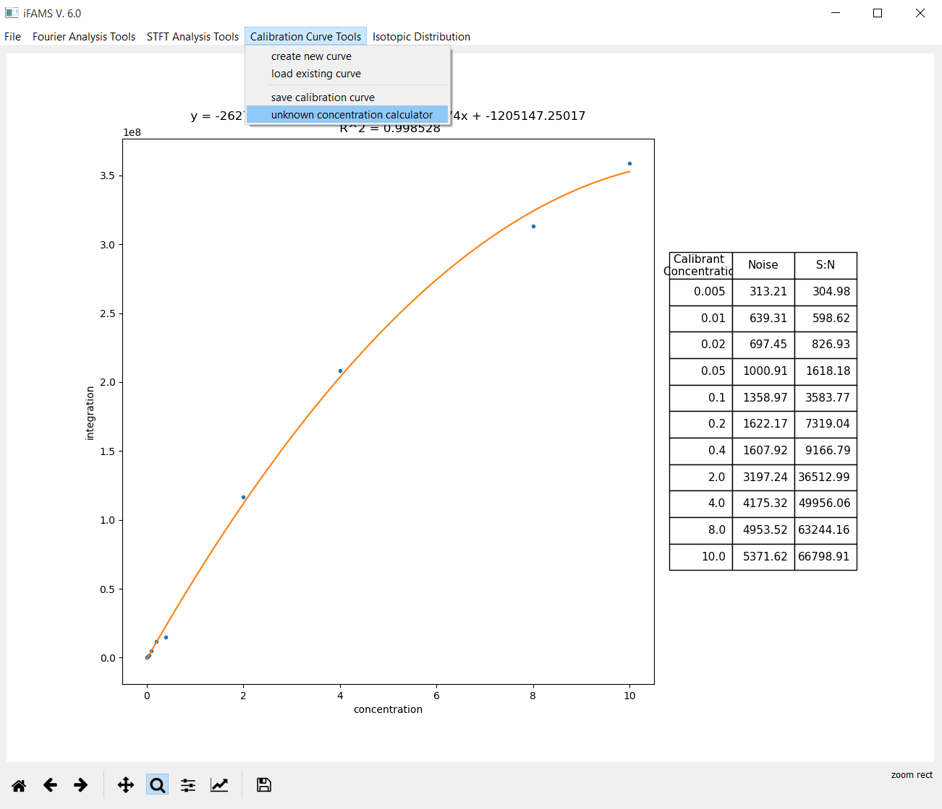
Determine unknown
concentrations by
using the “unknown
concentration calculator”.

Slide 47
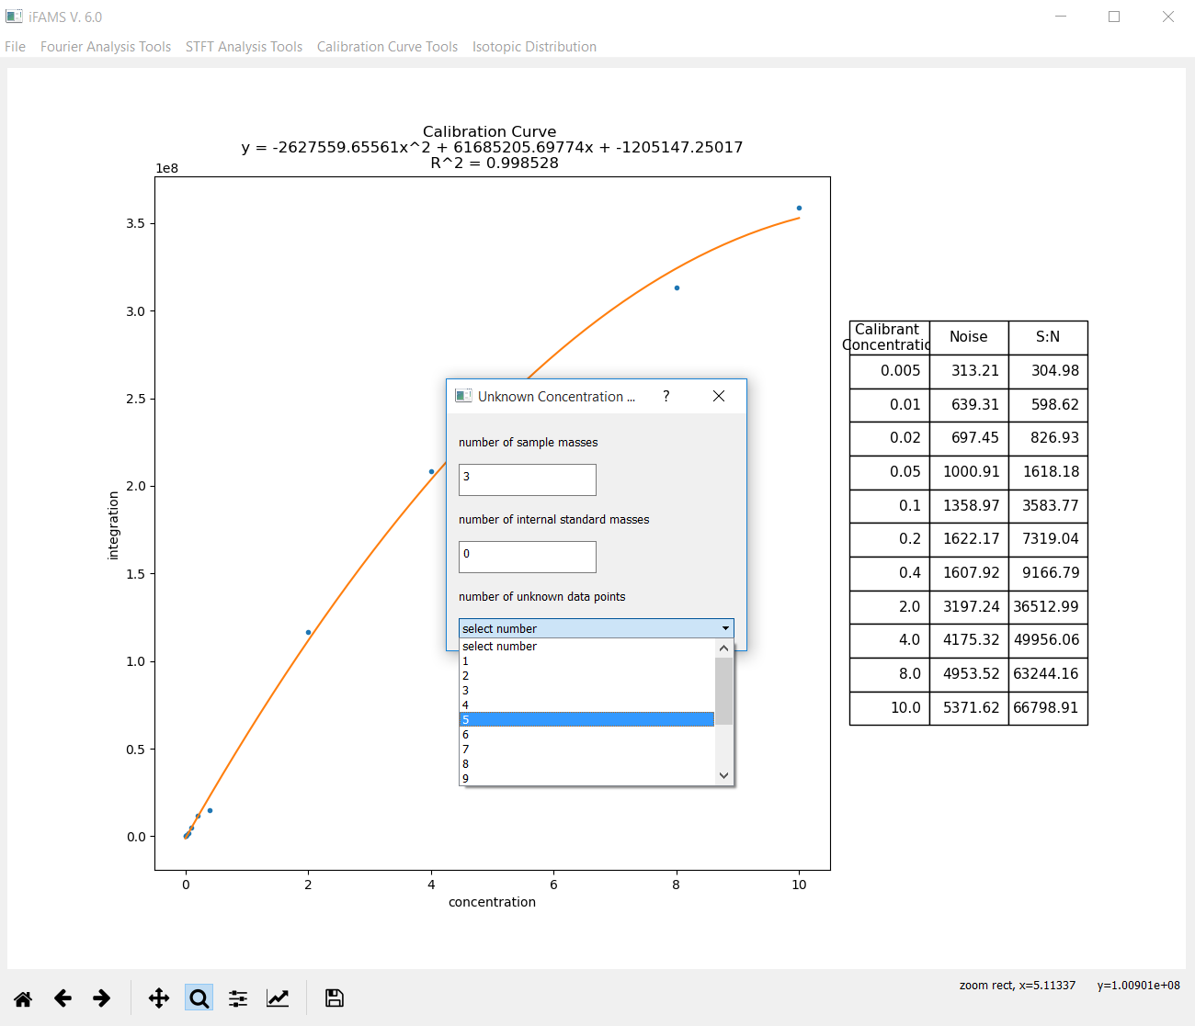
Again, specify how many
masses you will sum up
and how many unknown
files you have.

Slide 48
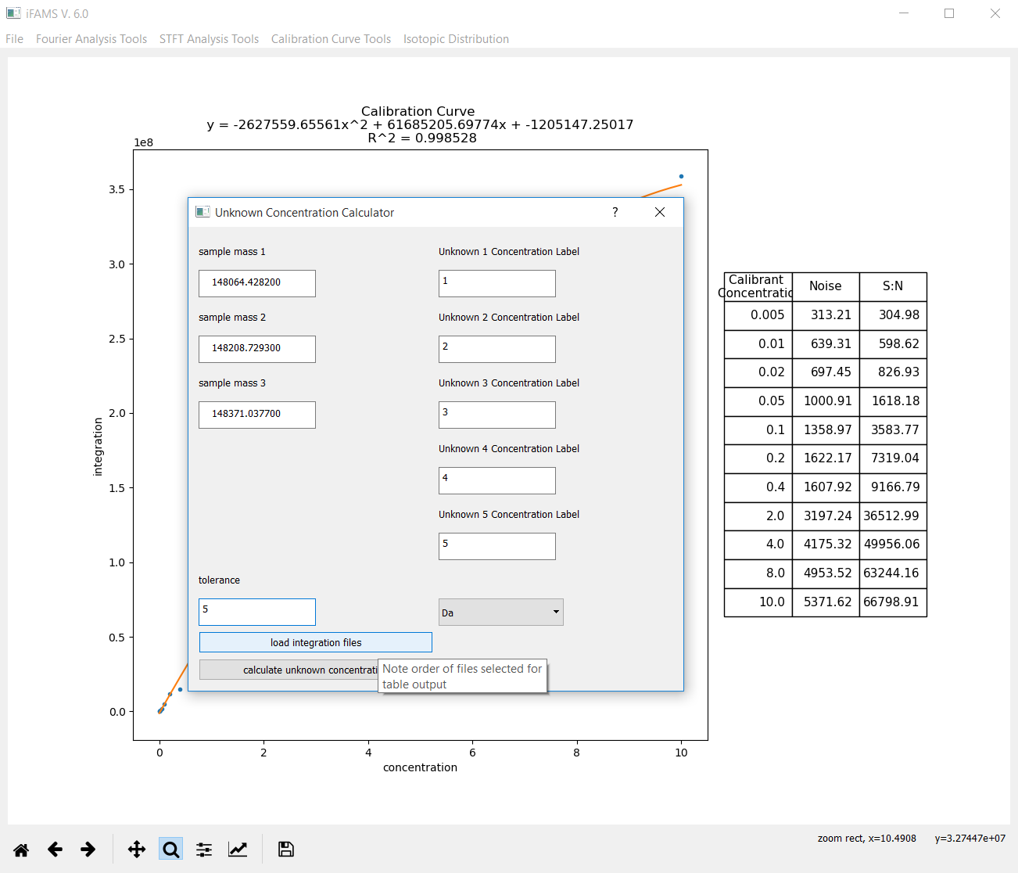
This step works exactly
the same way as it did
for the calibrant files.
For the “labels” of the
unknowns, you must
enter numbers.
We suggest just putting
1, 2, 3, … but anything
numerical is fine.

Slide 49
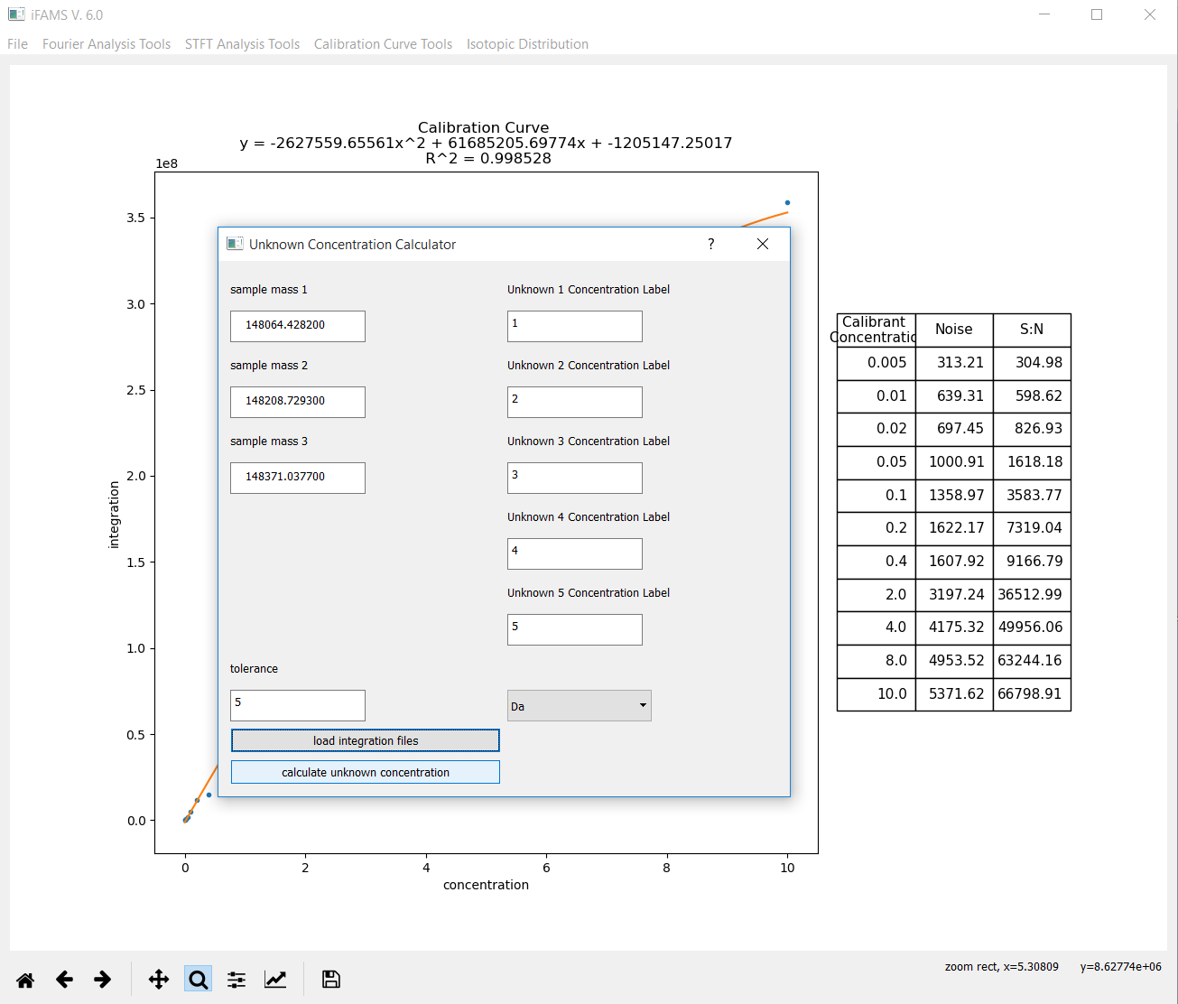
Once you have selected
the corresponding
unknown files, click
“calculate unknown
concentration”.

Slide 50
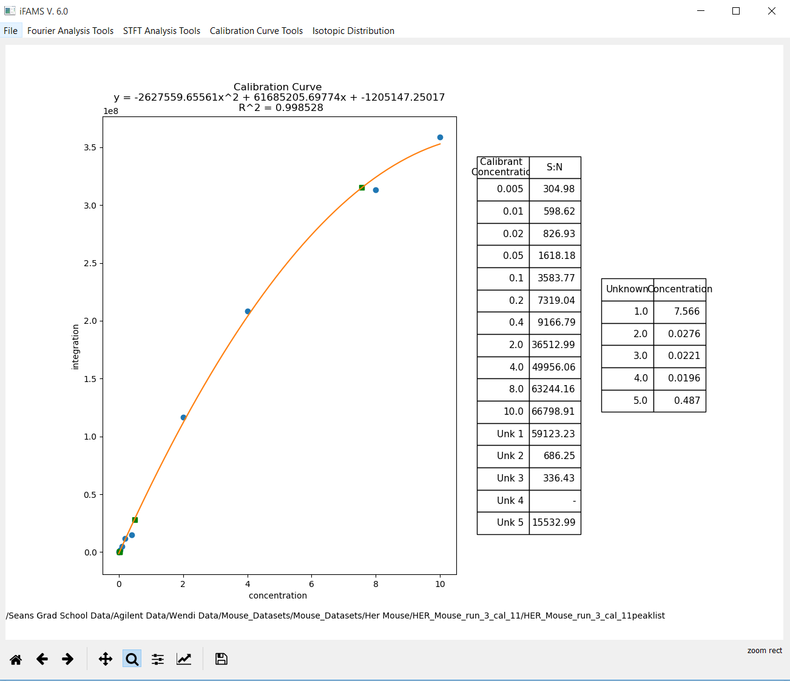
iFAMS has added the unknowns
to the graph (green squares)
and output a table with
the determined concentrations.

Slide 51
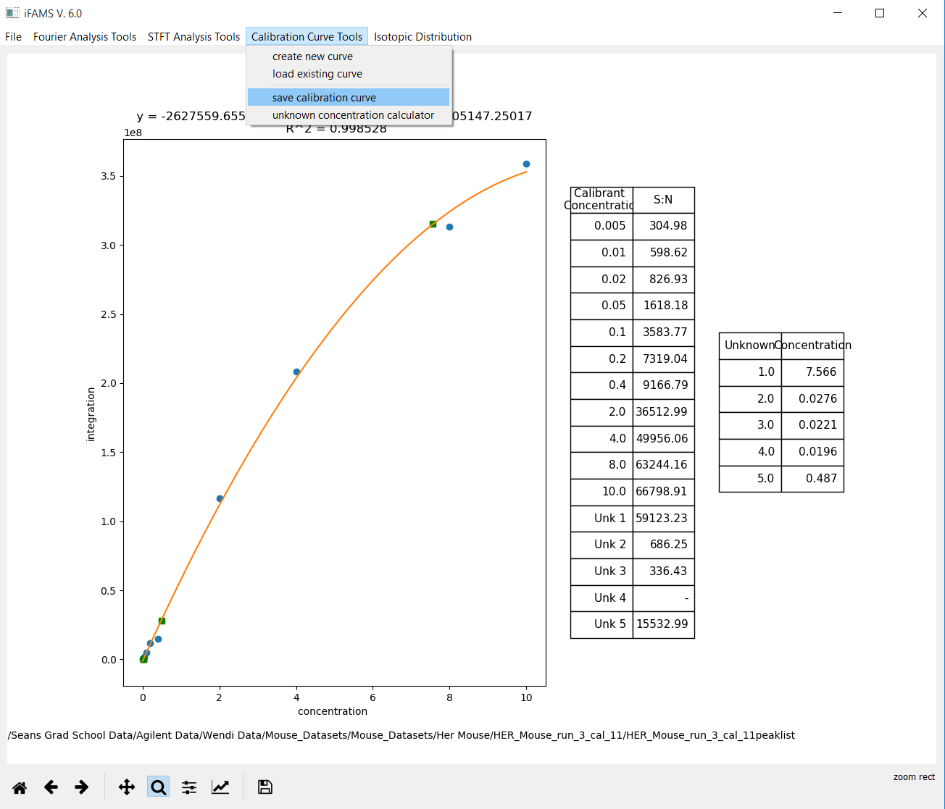
If you want to store the
calibration curve for
later use, save it from the
Calibration Curve Tools
menu.

Slide 52
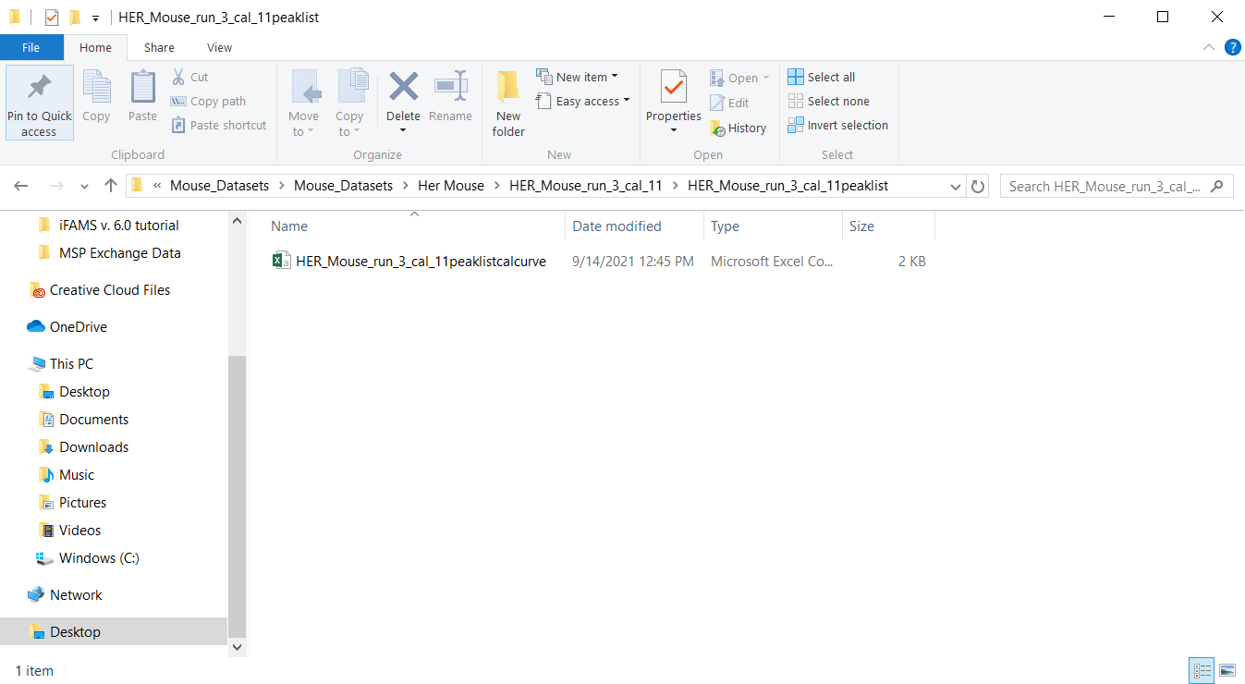
iFAMS will store the calibration curve (if you saved it) within the folder
for the last calibrant that you used. It will always end with “peaklistcalcurve”.

Slide 53
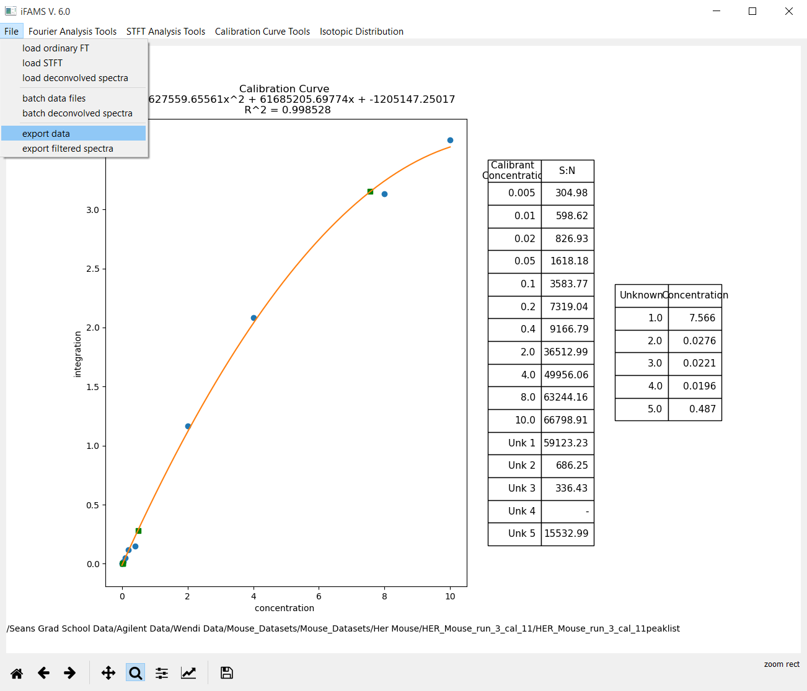
If you made it this far,
iFAMS will have already
stored all of the data
it created along the way
(charge-state-specific
zero-charge spectra and
corresponding IFTs,
the full FT, full zero-charge
spectrum, and integrated
peak lists) for each
file.
If at any point along the way
you want to save your data,
do this from the File menu
(“export data”). Normally,
you will not need to do
that.

